Slide 1
An opinionated guide to node embeddings
Anton Tsitsulin
Ph.D. student @ University of Bonn
Student Researcher @ Google

Slide 2
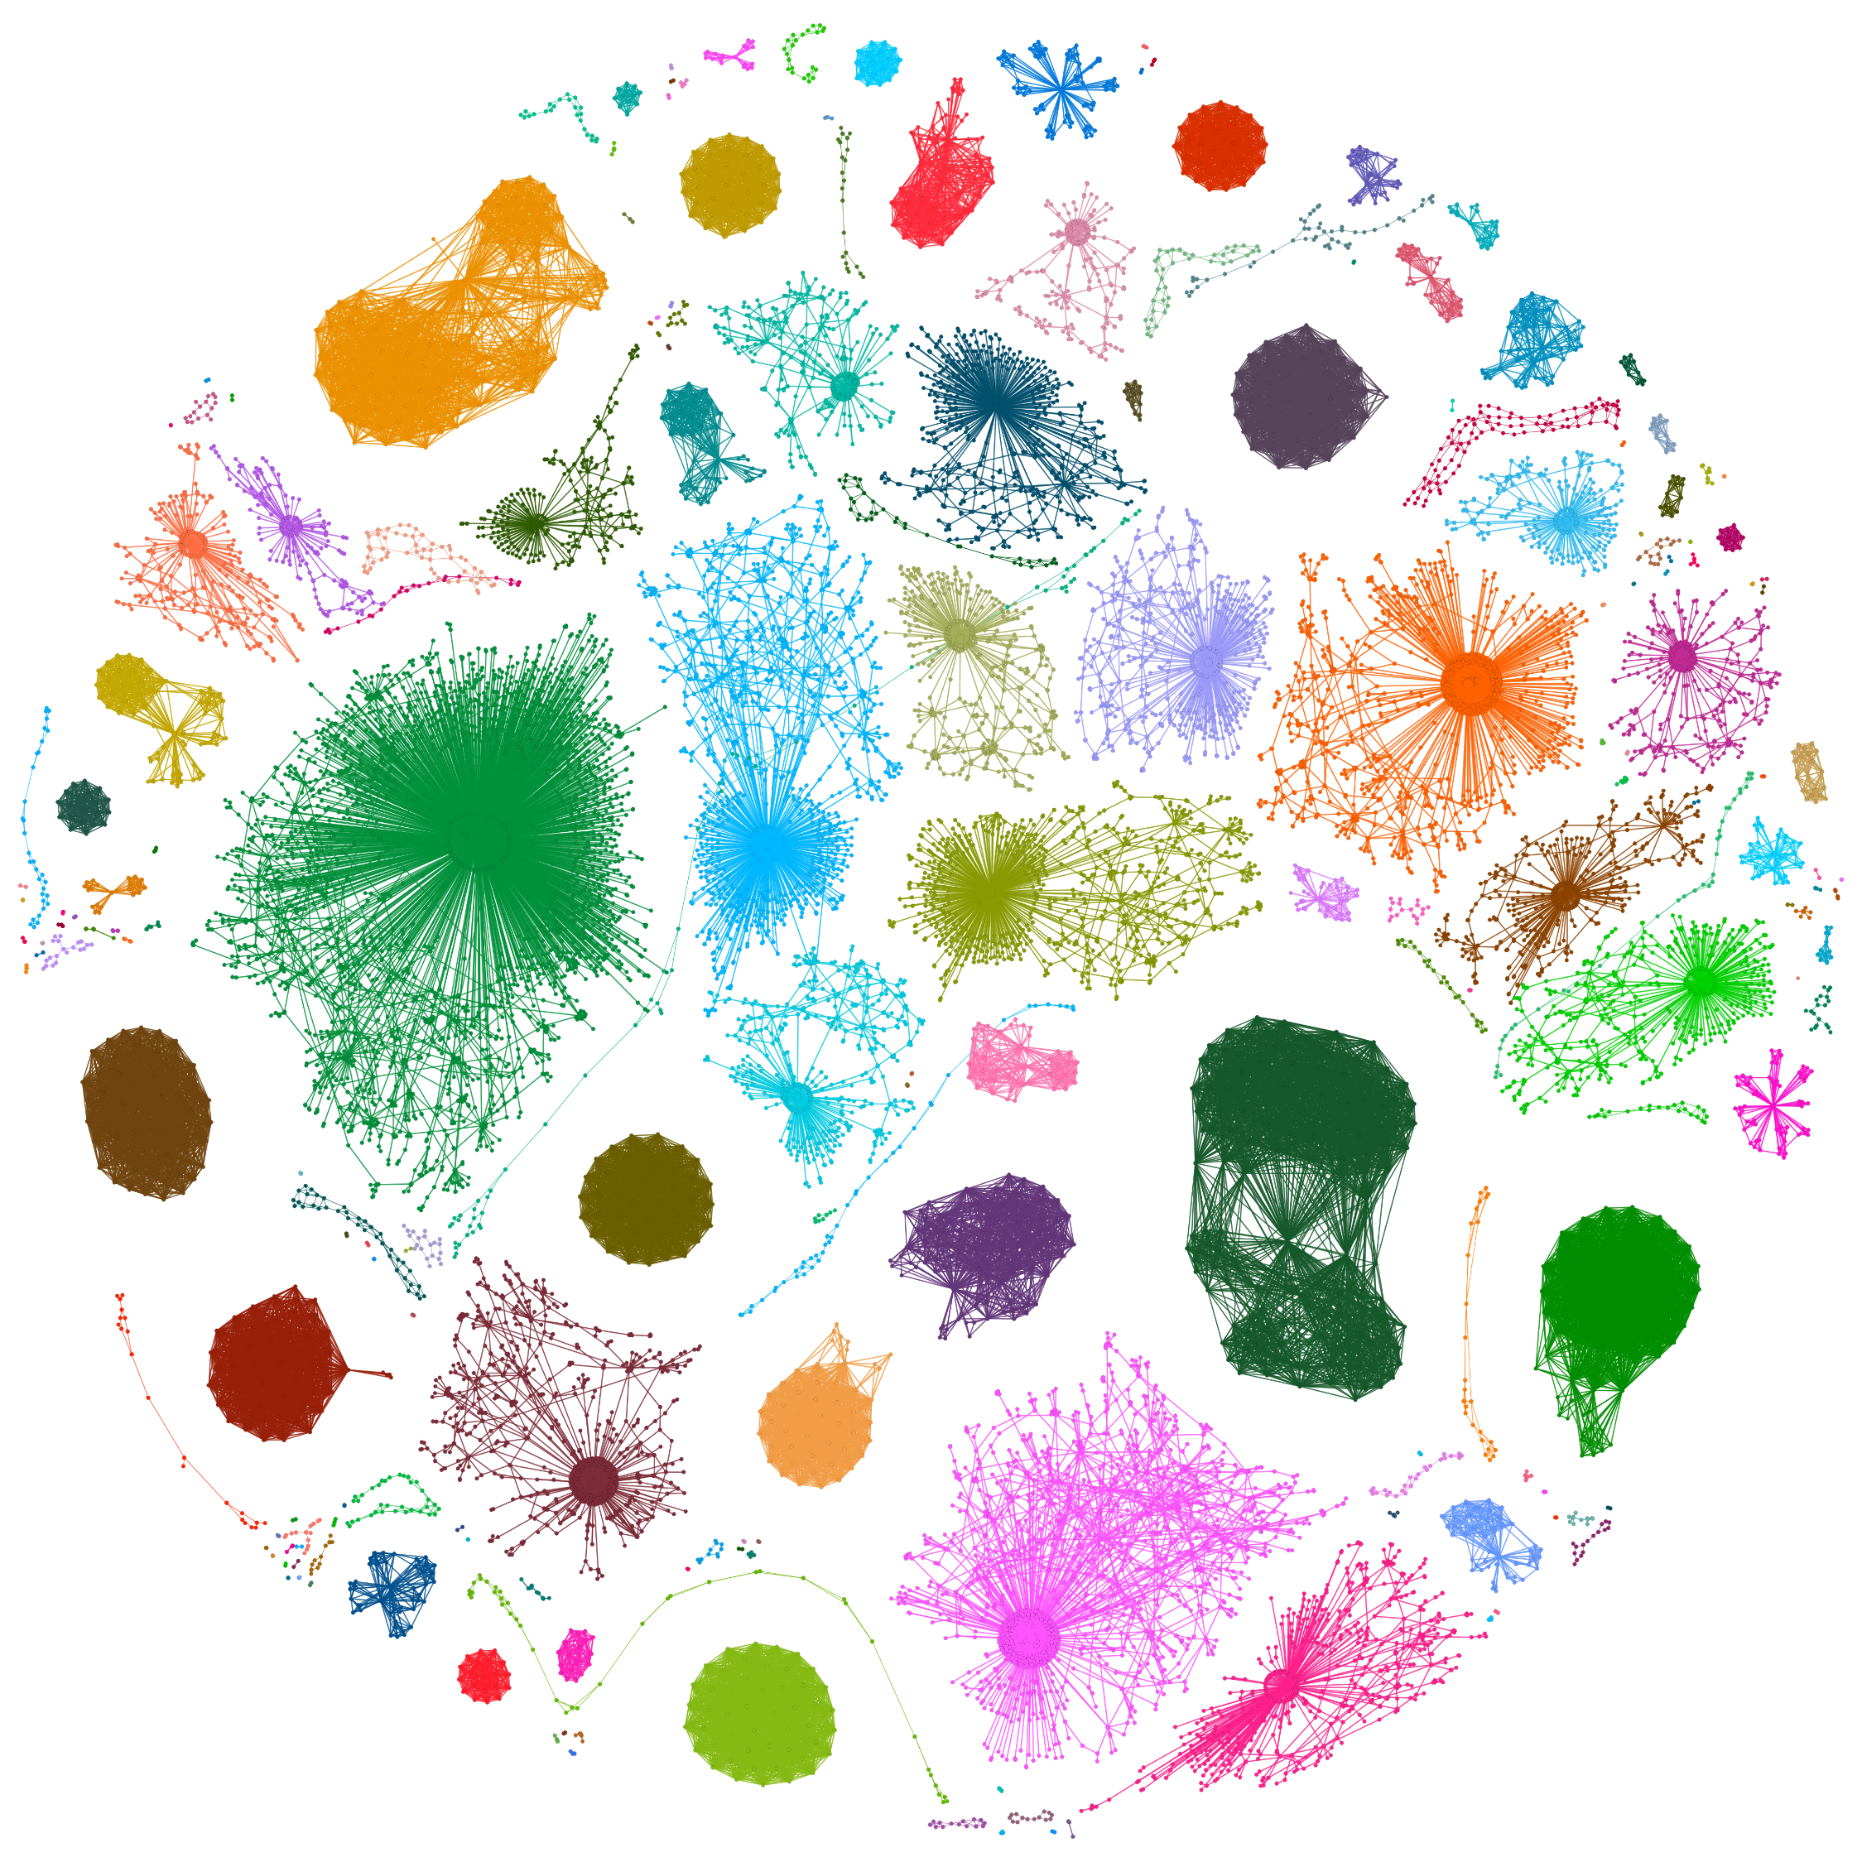
Graph world is diverse
Different domains:
  Information
  Social
  Biological
  Transportation
  …

Slide 3
Graph world is diverse
Different graph types:
  (Un)directed
  (Un)weighted
  Temporal
  Heterogeneous
  …

Slide 4
Graph world is diverse
Different modalities:
  Nodes
  Edges
  Motifs
  Subgraphs
  Whole graphs
  …

Slide 5
Graph world is diverse
Different tasks:
  Classification
  Clustering
  Anomaly detection
  …

Slide 6
Graph world is diverse
Domains
  Information
  Social
  Biological
  Transportation
Graph Types
  (Un)directed
  (Un)weighted
  Temporal
  Heterogeneous
Modalities
  Nodes
  Edges
  Subgraphs
  Whole graphs
Tasks
  Classification
  Clustering
  Anomaly detection

Slide 7
Graph world is diverse
Domains
  Information
  Social
  Biological
  Transportation
Graph Types
  (Un)directed
  (Un)weighted
  Temporal
  Heterogeneous
Modalities
  Nodes
  Edges
  Subgraphs
  Whole graphs
Tasks
  Classification
  Clustering
  Anomaly detection
  ↓
  Embeddings

Slide 8
Graph world is diverse
Domains
  Information
  Social
  Biological
  Transportation
Graph Types
  (Un)directed
  (Un)weighted
  Temporal
  Heterogeneous
Modalities
  Nodes
  Edges
  Subgraphs
  Whole graphs
Tasks
  Classification
  Clustering
  Anomaly detection
  ↓
  Embeddings
Notes:
In this talk in particular, I will focus on the embedding algorithms irrespective of the domain. I will not cover temporal or heterogeneous graphs, and I will only talk about embeddings of nodes.

Slide 9

Why representations?
We have fast & good algorithms for mining vector data…
low-dimensional representation
k-means
Clustering

Slide 10
Why representations?
We have fast & good algorithms for mining vector data…
low-dimensional representation
Log. regression
Classification

Slide 11
A brief history of node embeddings
LINE
2015
HOPE
2016
VERSE
2018
NetMF
2018
FastRP
2019
2009
SocioDim
2014
DeepWalk
2016
node2vec
2018
AROPE
2018
RandNE
2019
NodeSketch
neural wave
Factorization + sketching wave

Slide 12
Algorithm
1-sentence summary of the contribution
Overview and inner workings of the algorithm
Paper title. Authors, CONFERENCE YEAR

Slide 13
Neural node embeddings

Slide 14
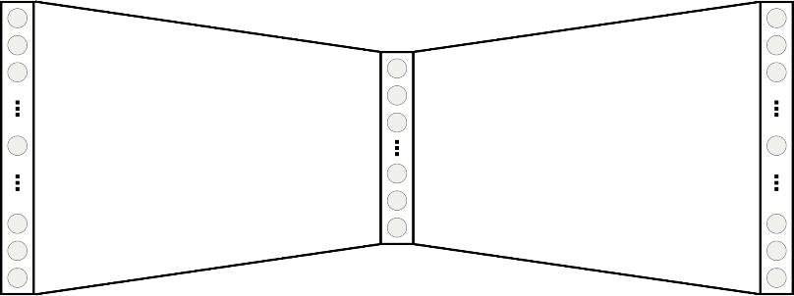


Anatomy of a neural embedding
Nodes in random walks $≈$ words in sentences $→$ use word2vec
Random walks^{[2,3,4]}
Self-supervised neural network^{[1]}
$$W$$
$$W^{T}$$
representation
[1] Efficient Estimation of Word Representations in Vector Space. Mikolov et al., NIPS 2013
[2] DeepWalk: Online Learning of Social Representations. Perozzi et al., KDD 2014
[3] node2vec: Scalable Feature Learning for Networks. Grover & Leskovec, KDD 2016
[4] VERSE: Versatile Graph Embeddings from Similarity Measures. Tsitsulin et al., WWW 2018

Slide 15


DeepWalk: algorithm overview
“Nodes in random walks $≈$ words in sentences $→$ use word2vec”
Start $γ$ random walks of length $t$from each node
Predictions with hierarchical softmax
$$W$$
$${W′}^{T}$$
two representations
use pairs within window size $w$
DeepWalk: Online Learning of Social Representations. Perozzi et al., KDD 2014

Slide 16
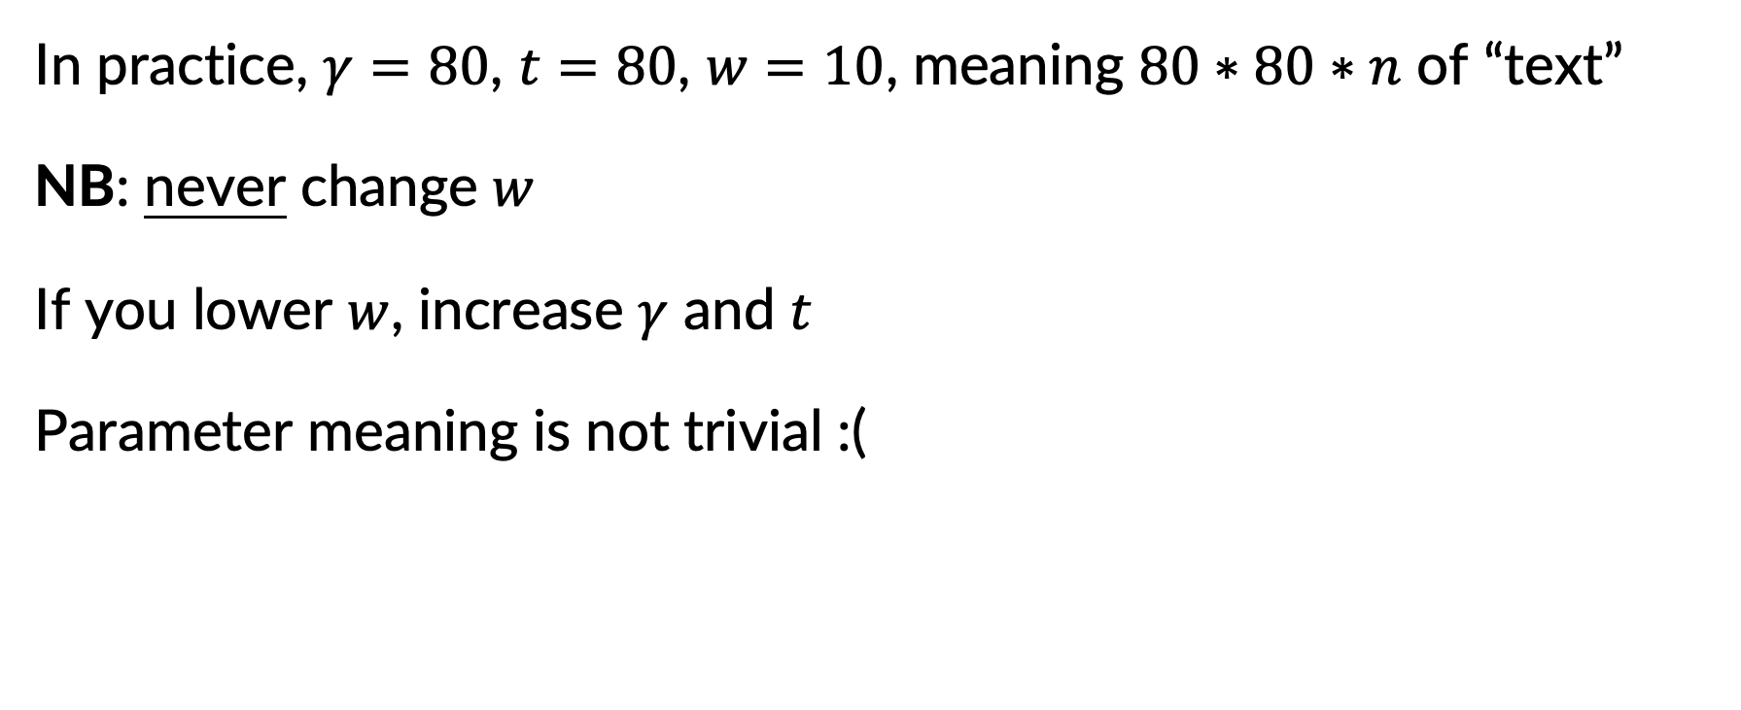
DeepWalk: asymptotics and practice
In practice, $γ=80$, $t=80$, $w=10$, meaning $80∗80∗n$ of “text”
NB: never change $w$
If you lower $w$, increase $γ$ and $t$
Parameter meaning is not trivial :(
DeepWalk: Online Learning of Social Representations. Perozzi et al., KDD 2014

Slide 17
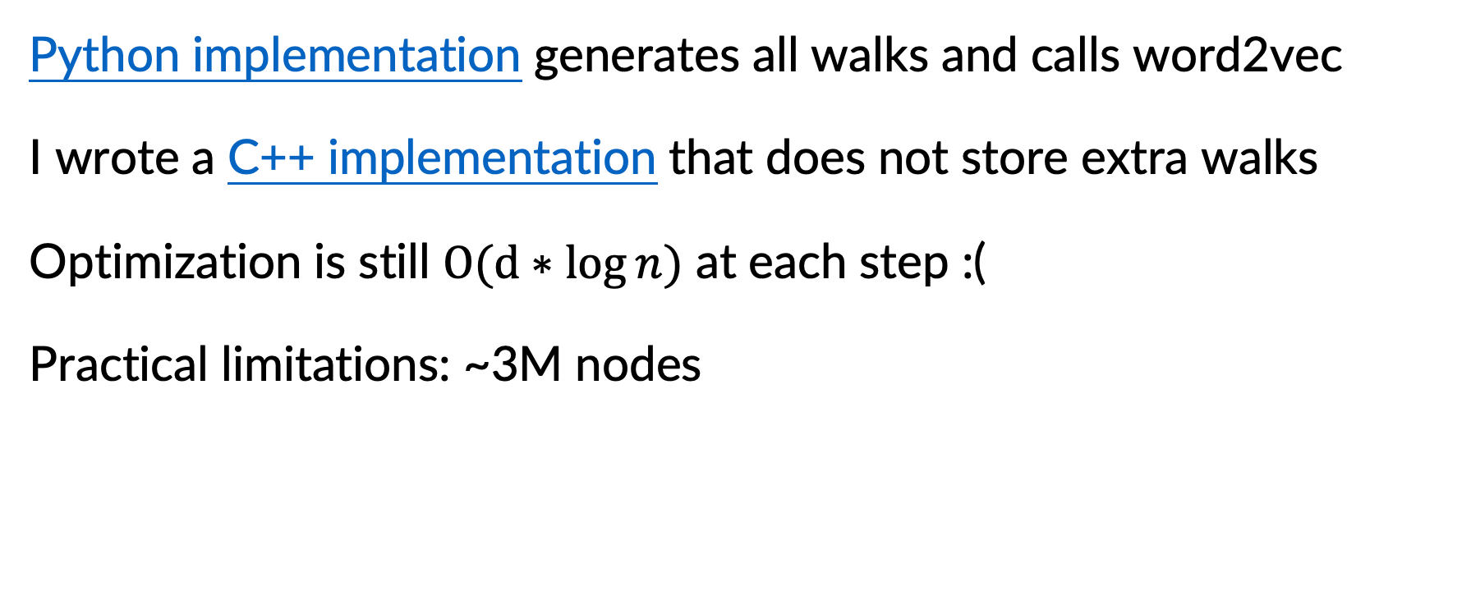
DeepWalk: asymptotics and practice
Python implementation generates all walks and calls word2vec
I wrote a C++ implementation that does not store extra walks
Optimization is still $O(d∗log{n)}$ at each step :(
Practical limitations: ~3M nodes
DeepWalk: Online Learning of Social Representations. Perozzi et al., KDD 2014

Slide 18


LINE: algorithm overview
“Why use random walks when edges do the trick”
Predictions with negative sampling
$$W$$
$${W′}^{T}$$
two representations
LINE: Large-scale information network embedding. Tang et al., WWW 2015

Slide 19
LINE: algorithm overview
“Why use random walks when edges do the trick”
Random edges
Predictions with negative sampling
$$W$$
$${W′}^{T}$$
two representations
LINE: Large-scale information network embedding. Tang et al., WWW 2015

Slide 20
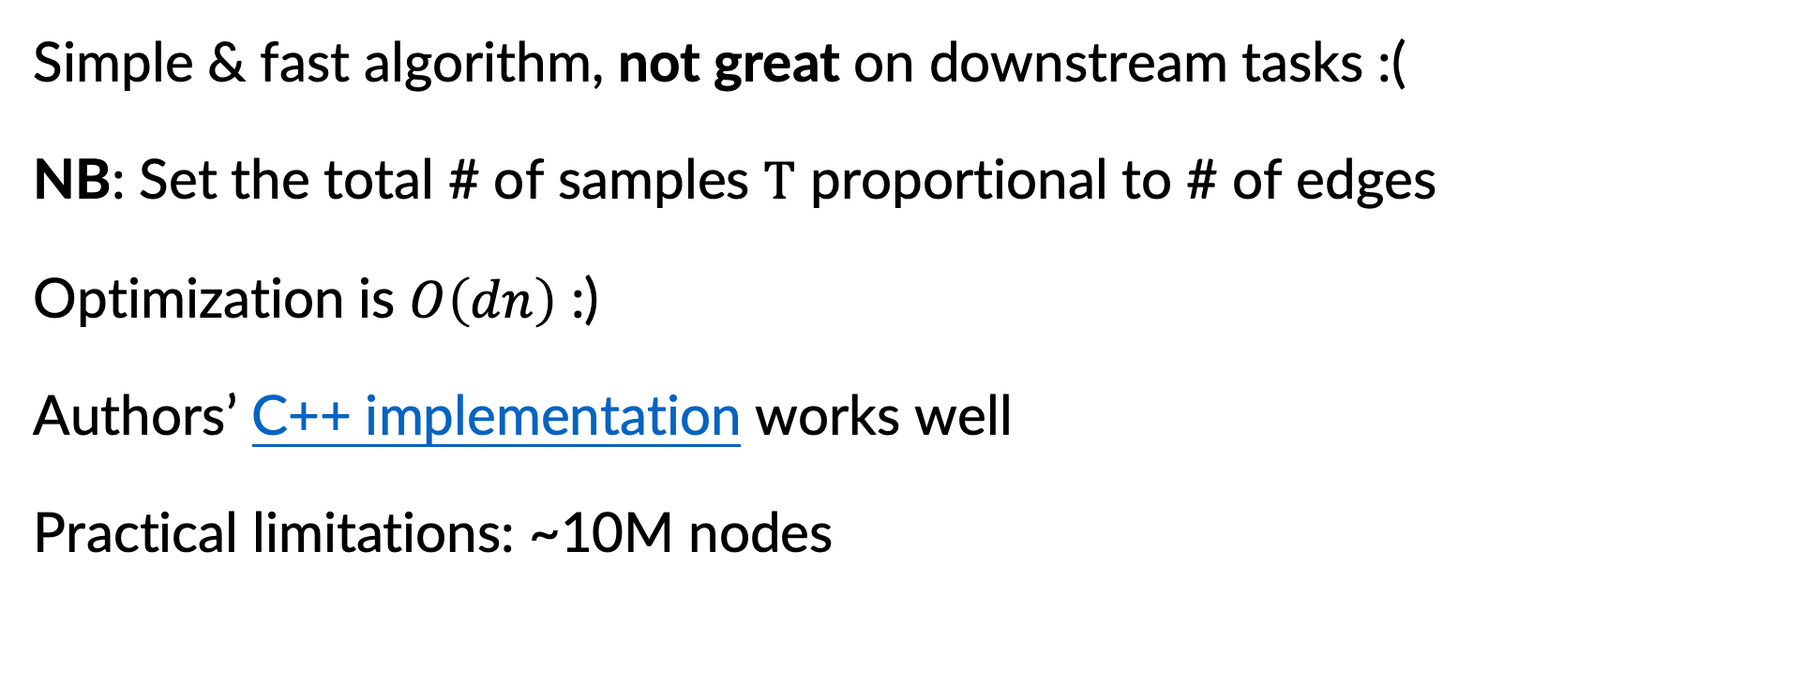
LINE: asymptotics and practice
Simple & fast algorithm, not great on downstream tasks :(
NB: Set the total # of samples $T$ proportional to # of edges
Optimization is $O\left(dn\right)$ :)
Authors’ C++ implementation works well
Practical limitations: ~10M nodes
LINE: Large-scale information network embedding. Tang et al., WWW 2015

Slide 21

Node2vec: algorithm overview
“Let’s add two more parameters $(p,q)$ to DeepWalk”
Start $γ$ random walks of length $t$from each node
Predictions with negative sampling
$$W$$
$${W′}^{T}$$
two representations
use pairs within window size $w$
Node2vec: scalable feature learning for networks. Grover & Leskovec, KDD 2016

Slide 22
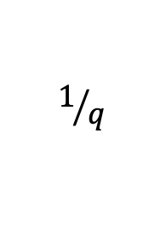
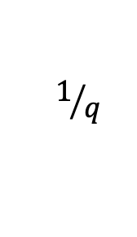



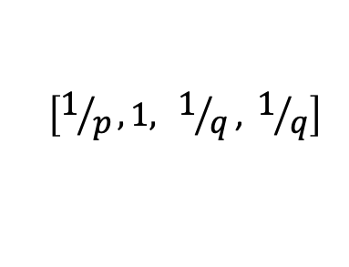

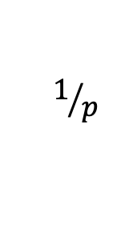

Node2vec: algorithm overview
“Let’s add two more parameters $(p,q)$ to DeepWalk”
Use second-order random walk sampling
$$u$$
$$v$$
Predictions with negative sampling
$$u$$
$$1/p$$
$$1/q$$
$$1$$
$$W$$
$${W′}^{T}$$
$$v$$
$$1/q$$
two representations
$$\left[1/p, 1,{ 1}/q\text{, }1/q\right]$$
Node2vec: scalable feature learning for networks. Grover & Leskovec, KDD 2016

Slide 23
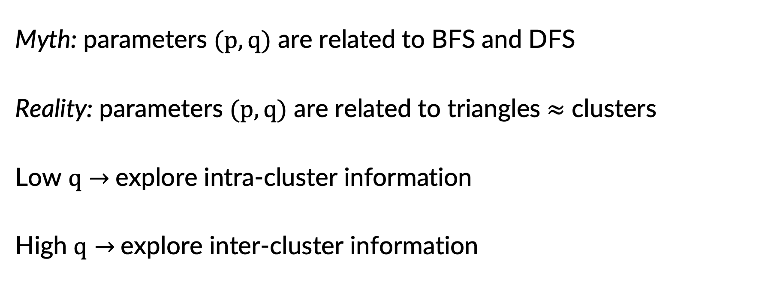
Node2vec: myth 1
Myth: parameters $(p,q)$ are related to BFS and DFS
Reality: parameters $(p,q)$ are related to triangles $≈$ clusters
Low $q→$explore intra-cluster information
High $q→$explore inter-cluster information
Node2vec: scalable feature learning for networks. Grover & Leskovec, KDD 2016

Slide 24
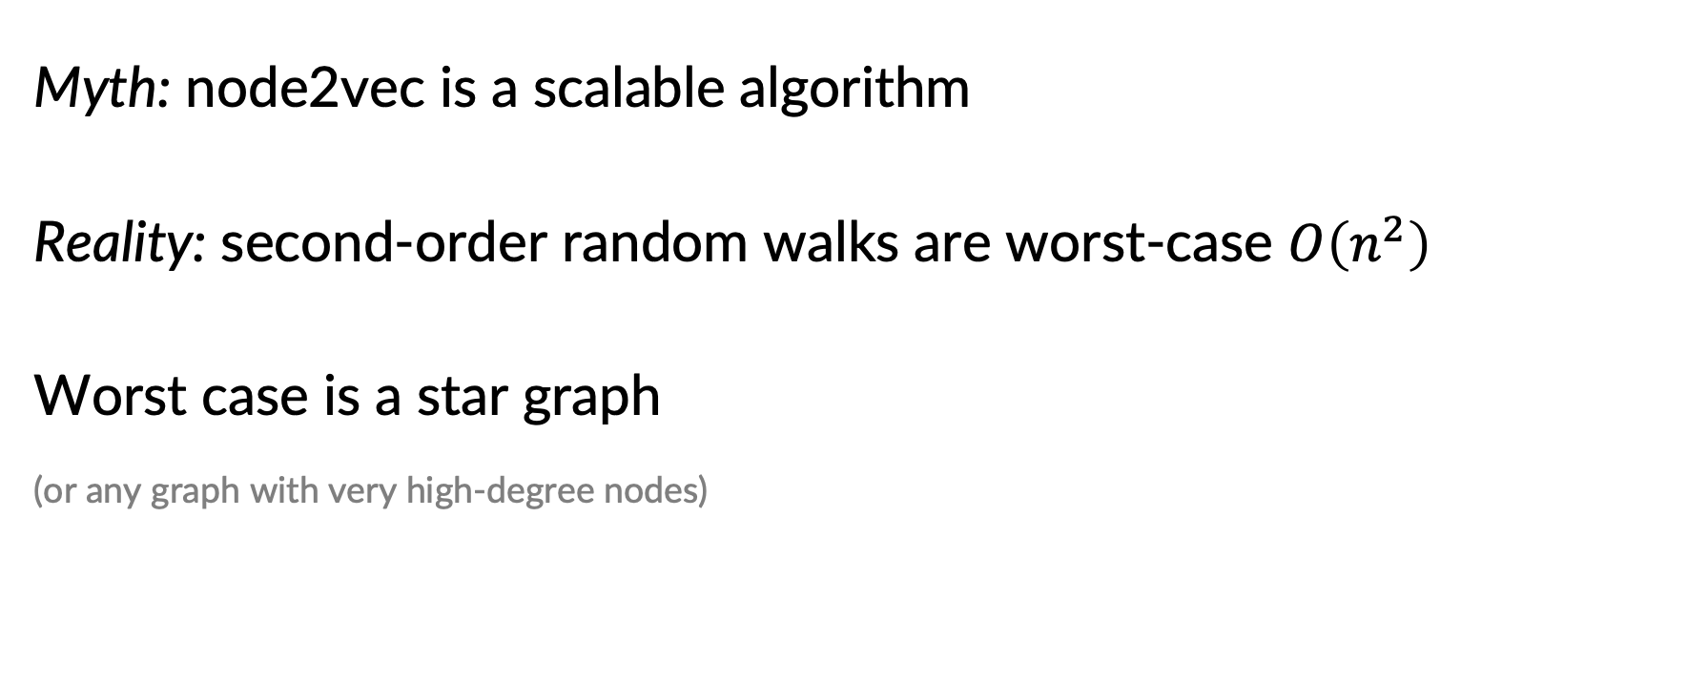
Node2vec: myth 2
Myth: node2vec is a scalable algorithm
Reality: second-order random walks are worst-case $O\left(n^{2}\right)$
Worst case is a star graph
(or any graph with very high-degree nodes)
Node2vec: scalable feature learning for networks. Grover & Leskovec, KDD 2016

Slide 25
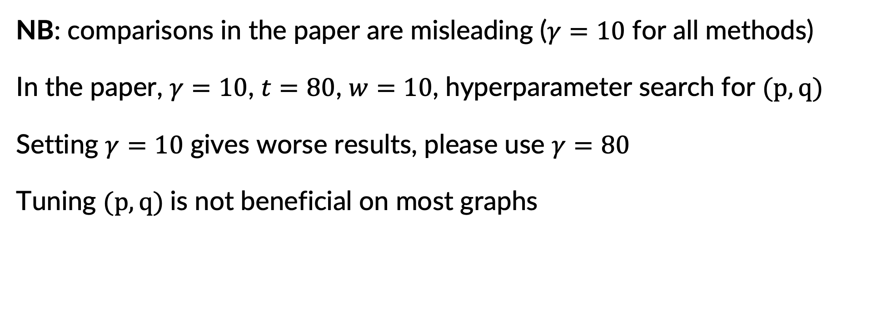
Node2vec: asymptotics and practice
NB: comparisons in the paper are misleading ($γ=10$ for all methods)
In the paper, $γ=10$, $t=80$, $w=10$, hyperparameter search for $(p,q)$
Setting $γ=10$ gives worse results, please use $γ=80$
Tuning $(p,q)$is not beneficial on most graphs
Node2vec: scalable feature learning for networks. Grover & Leskovec, KDD 2016

Slide 26
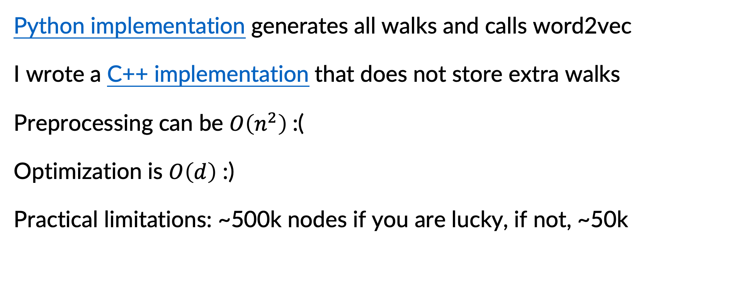
Node2vec: asymptotics and practice
Python implementation generates all walks and calls word2vec
I wrote a C++ implementation that does not store extra walks
Preprocessing can be $O\left(n^{2}\right)$:(
Optimization is $O\left(d\right)$ :)
Practical limitations: ~500k nodes if you are lucky, if not, ~50k
Node2vec: scalable feature learning for networks. Grover & Leskovec, KDD 2016

Slide 27
VERSE: algorithm overview
“Random walks define a similarity distribution”
Predictions with negative sampling
$$W$$
$$W^{T}$$
shared representation
VERSE: Versatile graph embeddings from similarity measures. Tsitsulin et al., WWW 2018

Slide 28
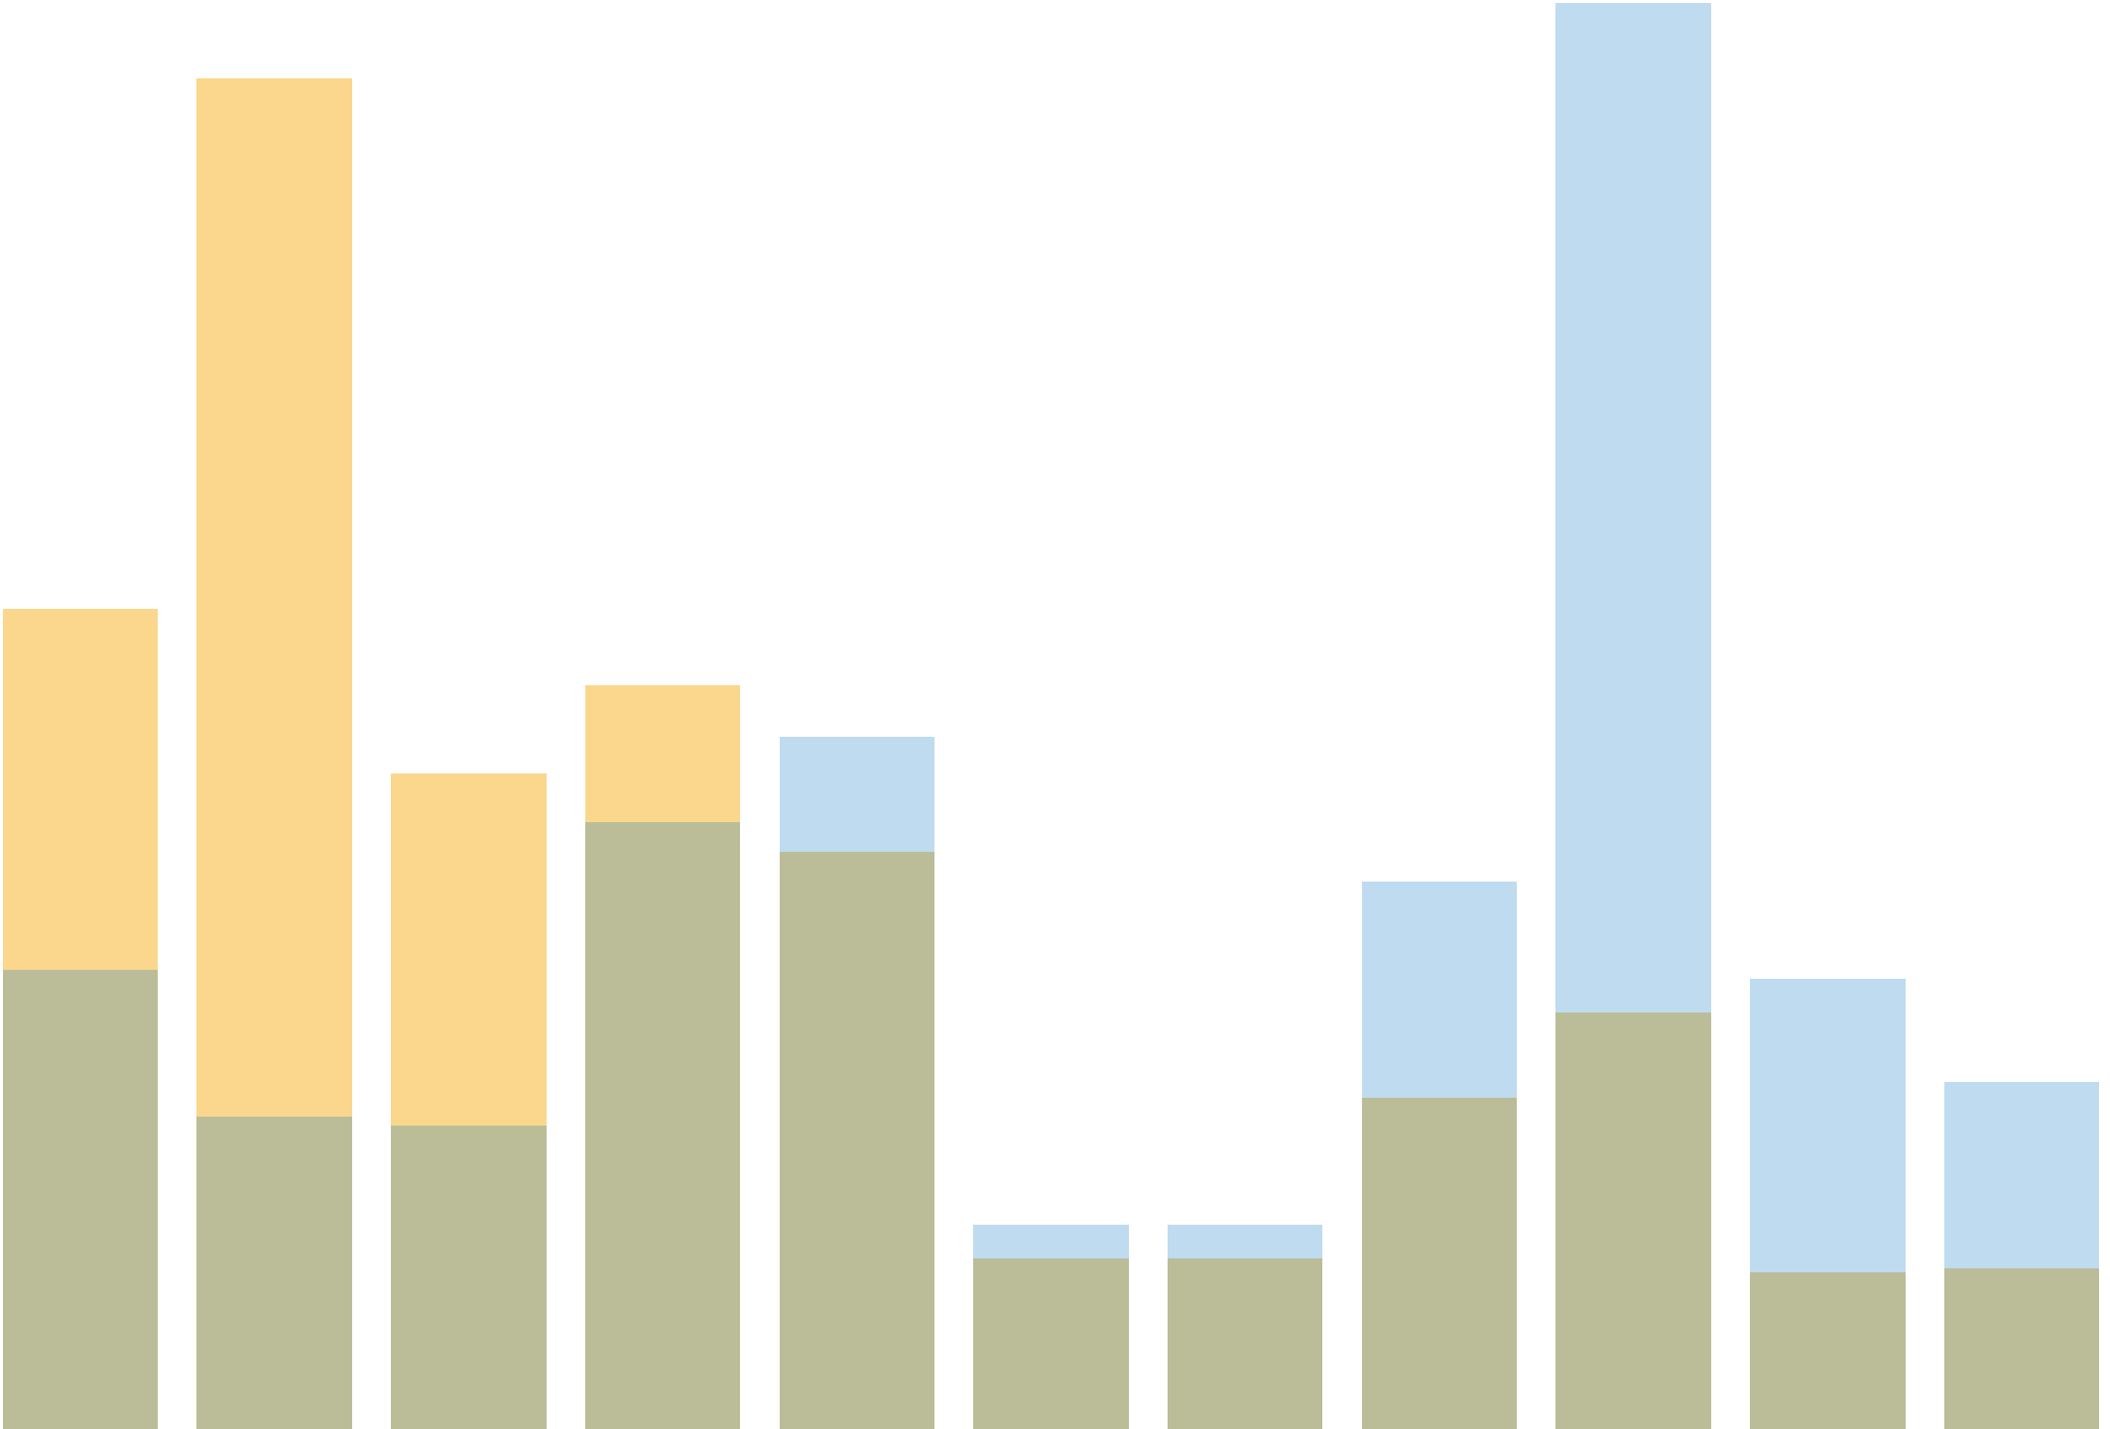






VERSE: algorithm overview
“Random walks define a similarity distribution”
Sample nodes from similarity distributions
$sim(u,⋅)$
$sim(v,⋅)$
$$u$$
Predictions with negative sampling
$$v$$
$$W$$
$$W^{T}$$
$$u$$
$$v$$
shared representation
VERSE: Versatile graph embeddings from similarity measures. Tsitsulin et al., WWW 2018

Slide 29
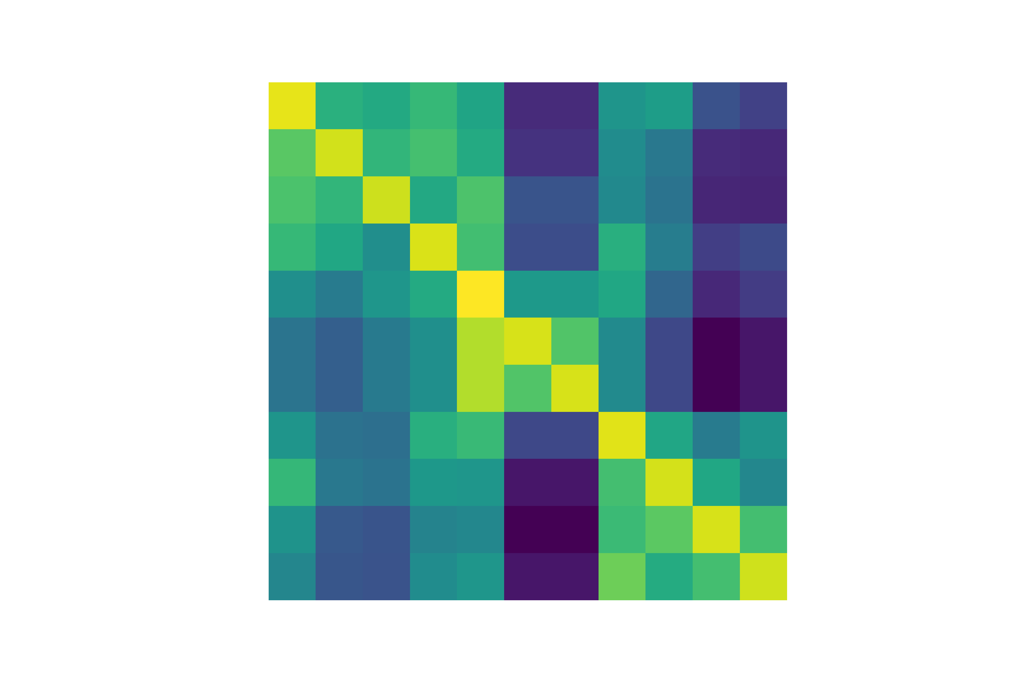

VERSE: algorithm overview
“Random walks define a similarity distribution”
Sample nodes from similarity distributions
$$u$$
Predictions with negative sampling
$$u$$
$$v$$
$$W$$
$$W^{T}$$
$$v$$
shared representation
Full similarity matrix $M$ is never materialized
VERSE: Versatile graph embeddings from similarity measures. Tsitsulin et al., WWW 2018

Slide 30
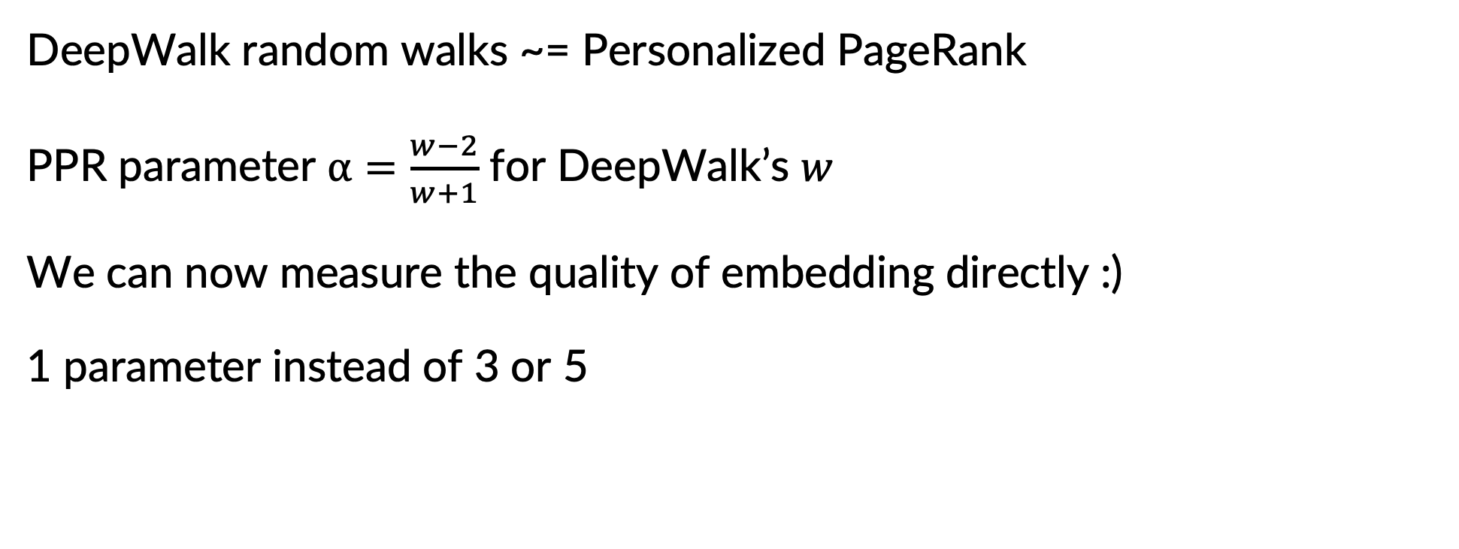
VERSE: interpretation of DeepWalk
DeepWalk random walks ~= Personalized PageRank
PPR parameter $α=\frac{w−2}{w+1}$ for DeepWalk’s $w$
We can now measure the quality of embedding directly :)
1 parameter instead of 3 or 5
VERSE: Versatile graph embeddings from similarity measures. Tsitsulin et al., WWW 2018

Slide 31
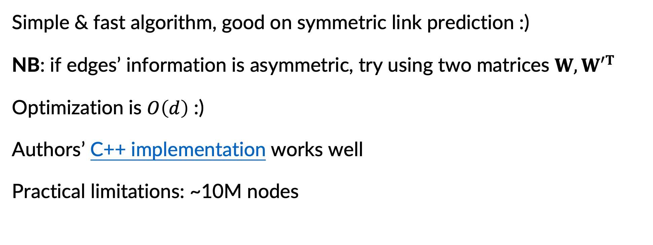
VERSE: asymptotics and practice
Simple & fast algorithm, good on symmetric link prediction :)
NB: if edges’ information is asymmetric, try using two matrices $W, {W′}^{T}$
Optimization is $O\left(d\right)$ :)
Authors’ C++ implementation works well
Practical limitations: ~10M nodes
VERSE: Versatile graph embeddings from similarity measures. Tsitsulin et al., WWW 2018

Slide 32
Factorization embeddings

Slide 33


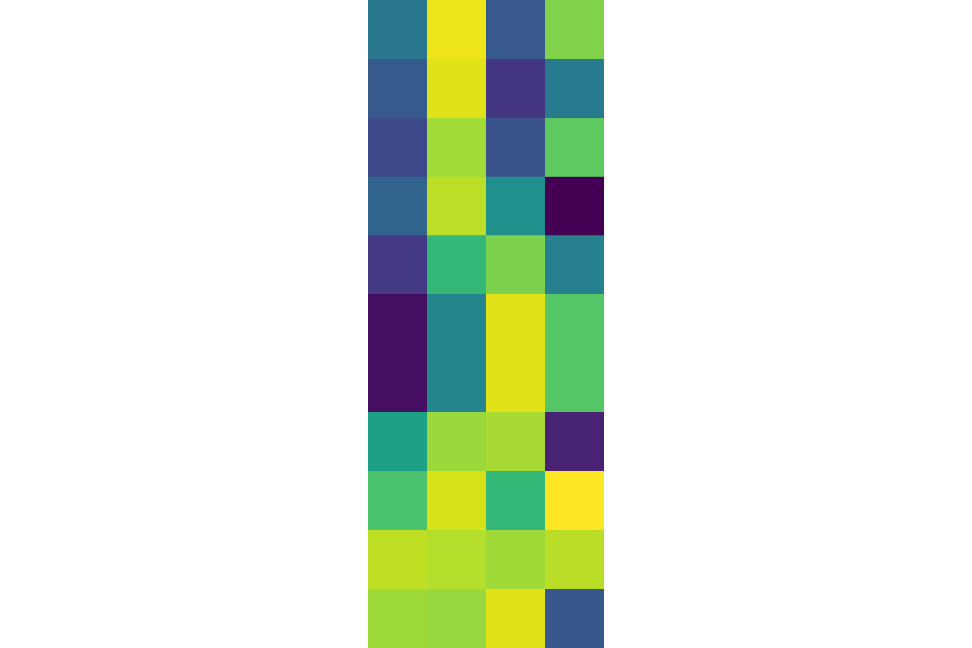



Anatomy of a factorization embedding
Construct a similarity matrix $→$ do SVD
$$U$$
$$Σ$$
$$V^{T}$$
[1] Asymmetric transitivity preserving graph embedding. Ou et al., KDD 2016
[2] Arbitrary-order proximity preserved network embedding. Zhang et al., KDD 2018
[3] Network embedding as matrix factorization: Unifying DeepWalk, LINE, PTE, and node2vec. Qiu et al., WSDM 2018

Slide 34
HOPE: algorithm overview
Do SVD on an implicit similarity matrix with sparse updates
$$U$$
$$Σ$$
$$V^{T}$$
Asymmetric transitivity preserving graph embedding. Ou et al., KDD 2016

Slide 35
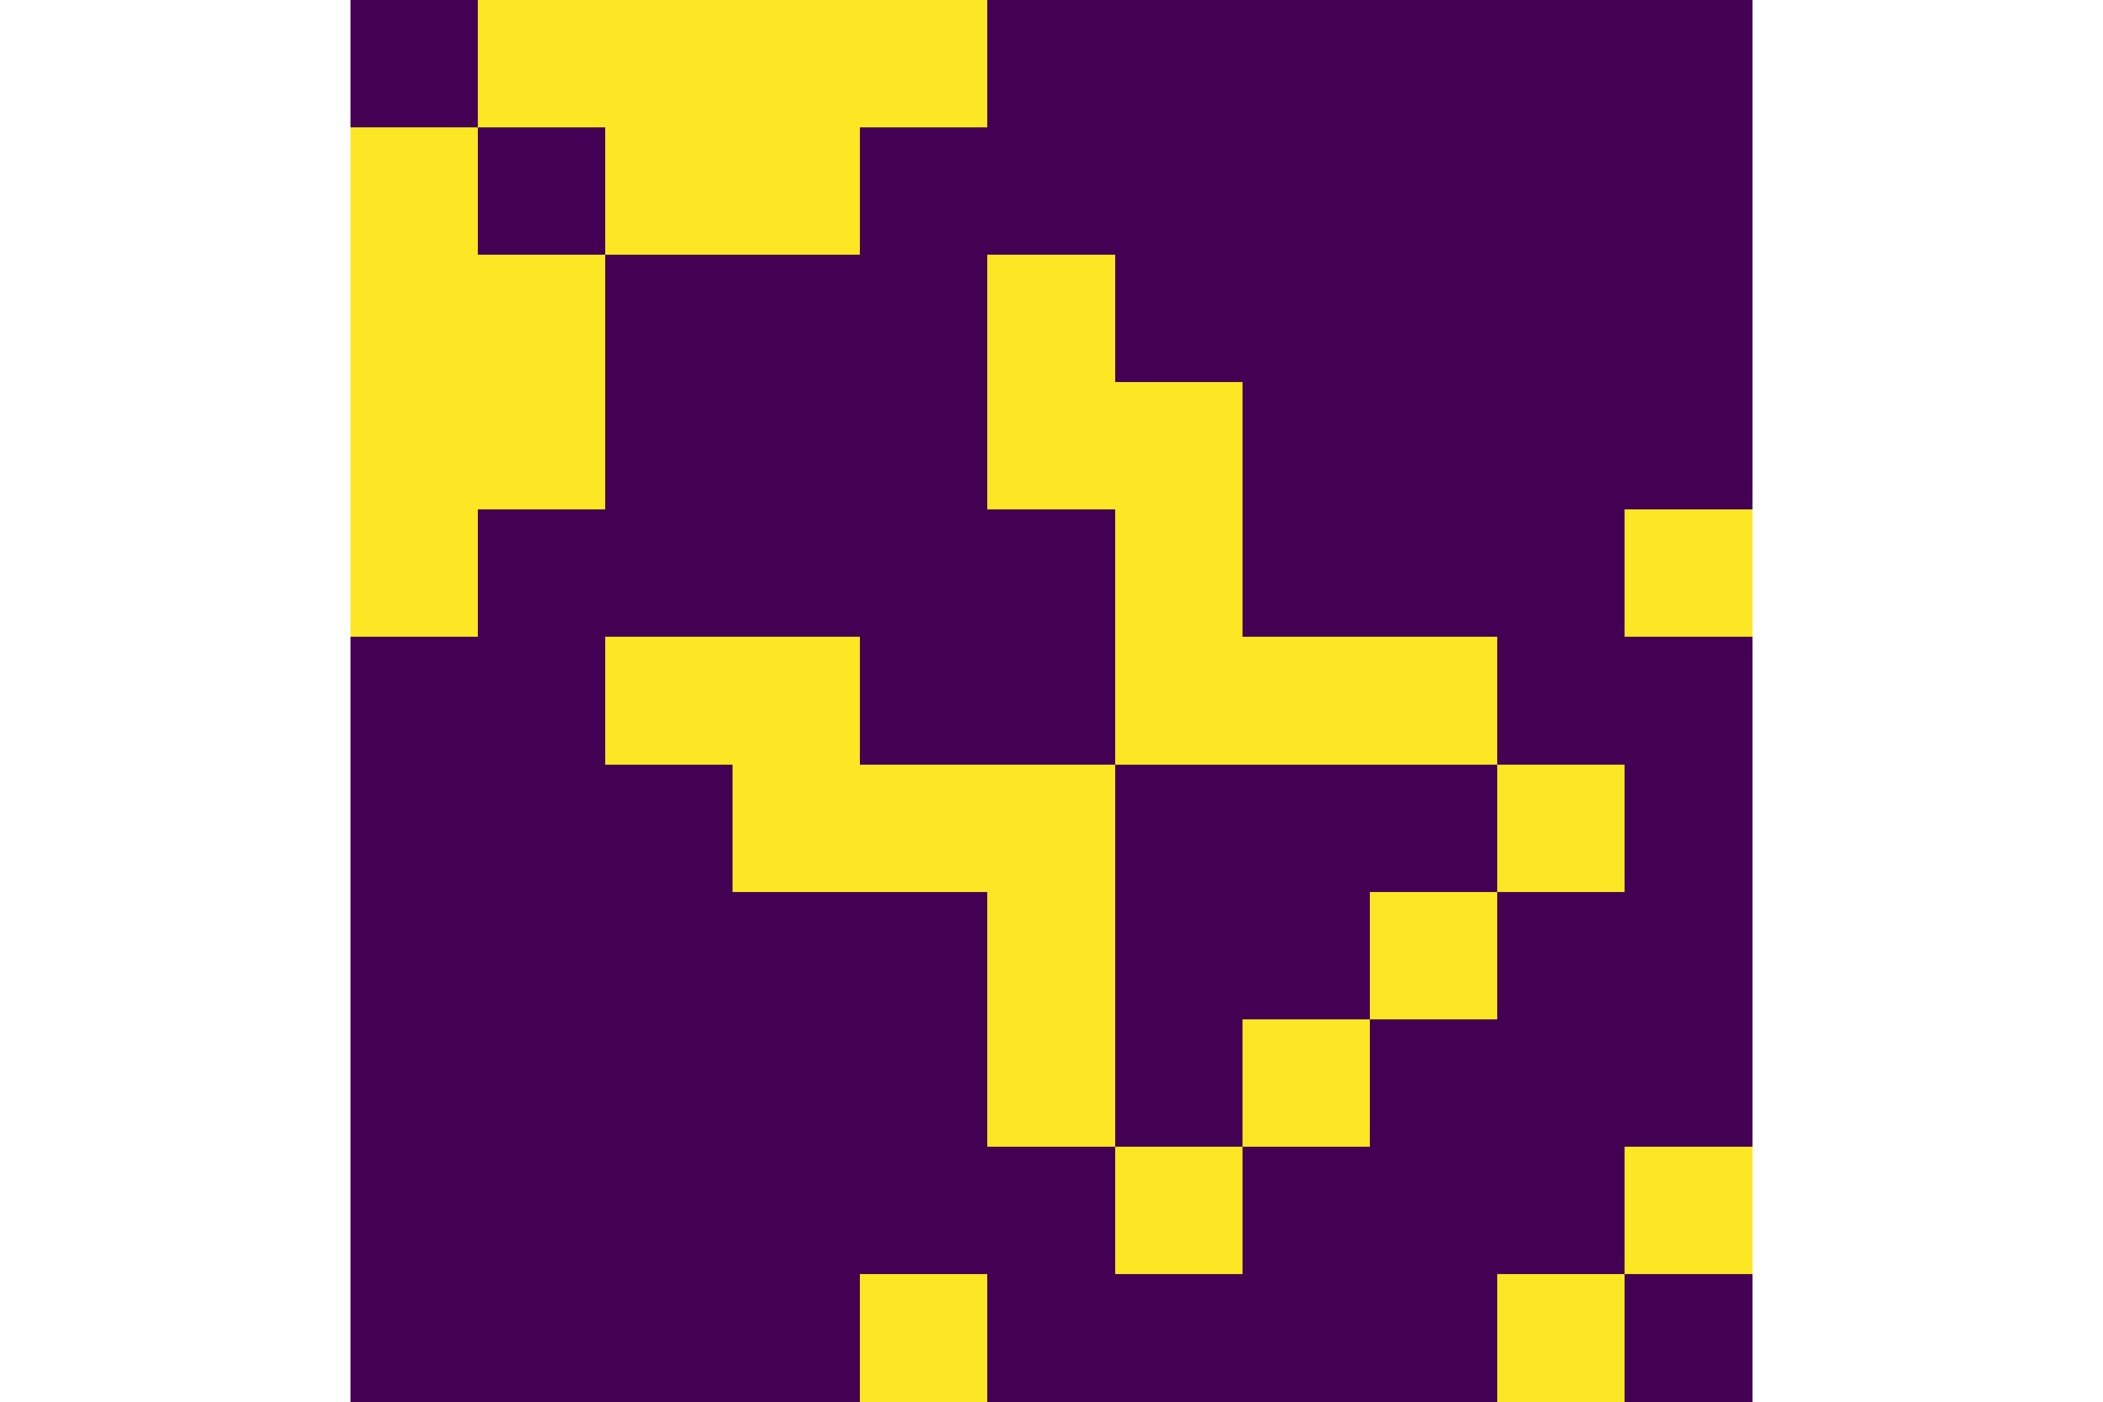
HOPE: algorithm overview
Do SVD on an implicit similarity matrix with sparse updates
JDGSVD decomposes dense similarity matrices of the form $M_{A}^{−1}M_{B}$
PPR / Katz similarity
Asymmetric transitivity preserving graph embedding. Ou et al., KDD 2016

Slide 36
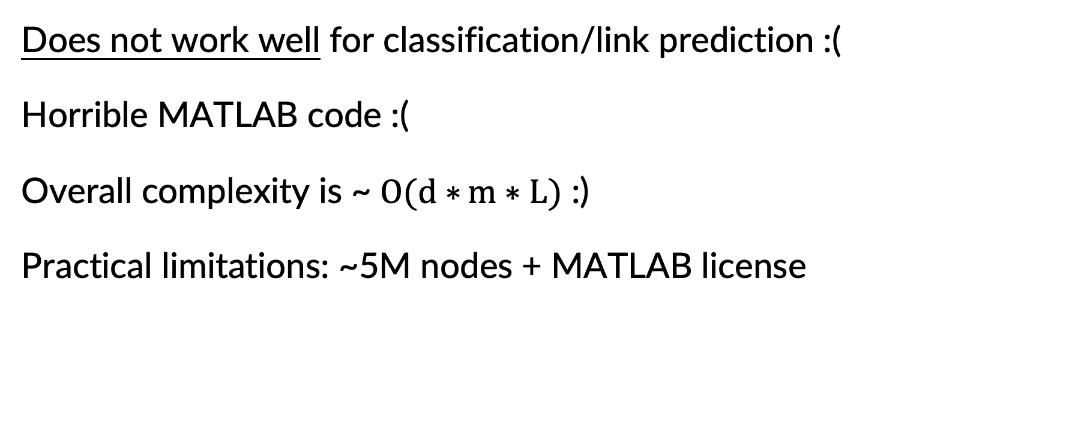
HOPE: asymptotics and practice
Does not work well for classification/link prediction :(
Horrible MATLAB code :(
Overall complexity is ~ $O(d∗{m∗L)}$ :)
Practical limitations: ~5M nodes + MATLAB license
Asymmetric transitivity preserving graph embedding. Ou et al., KDD 2016

Slide 37


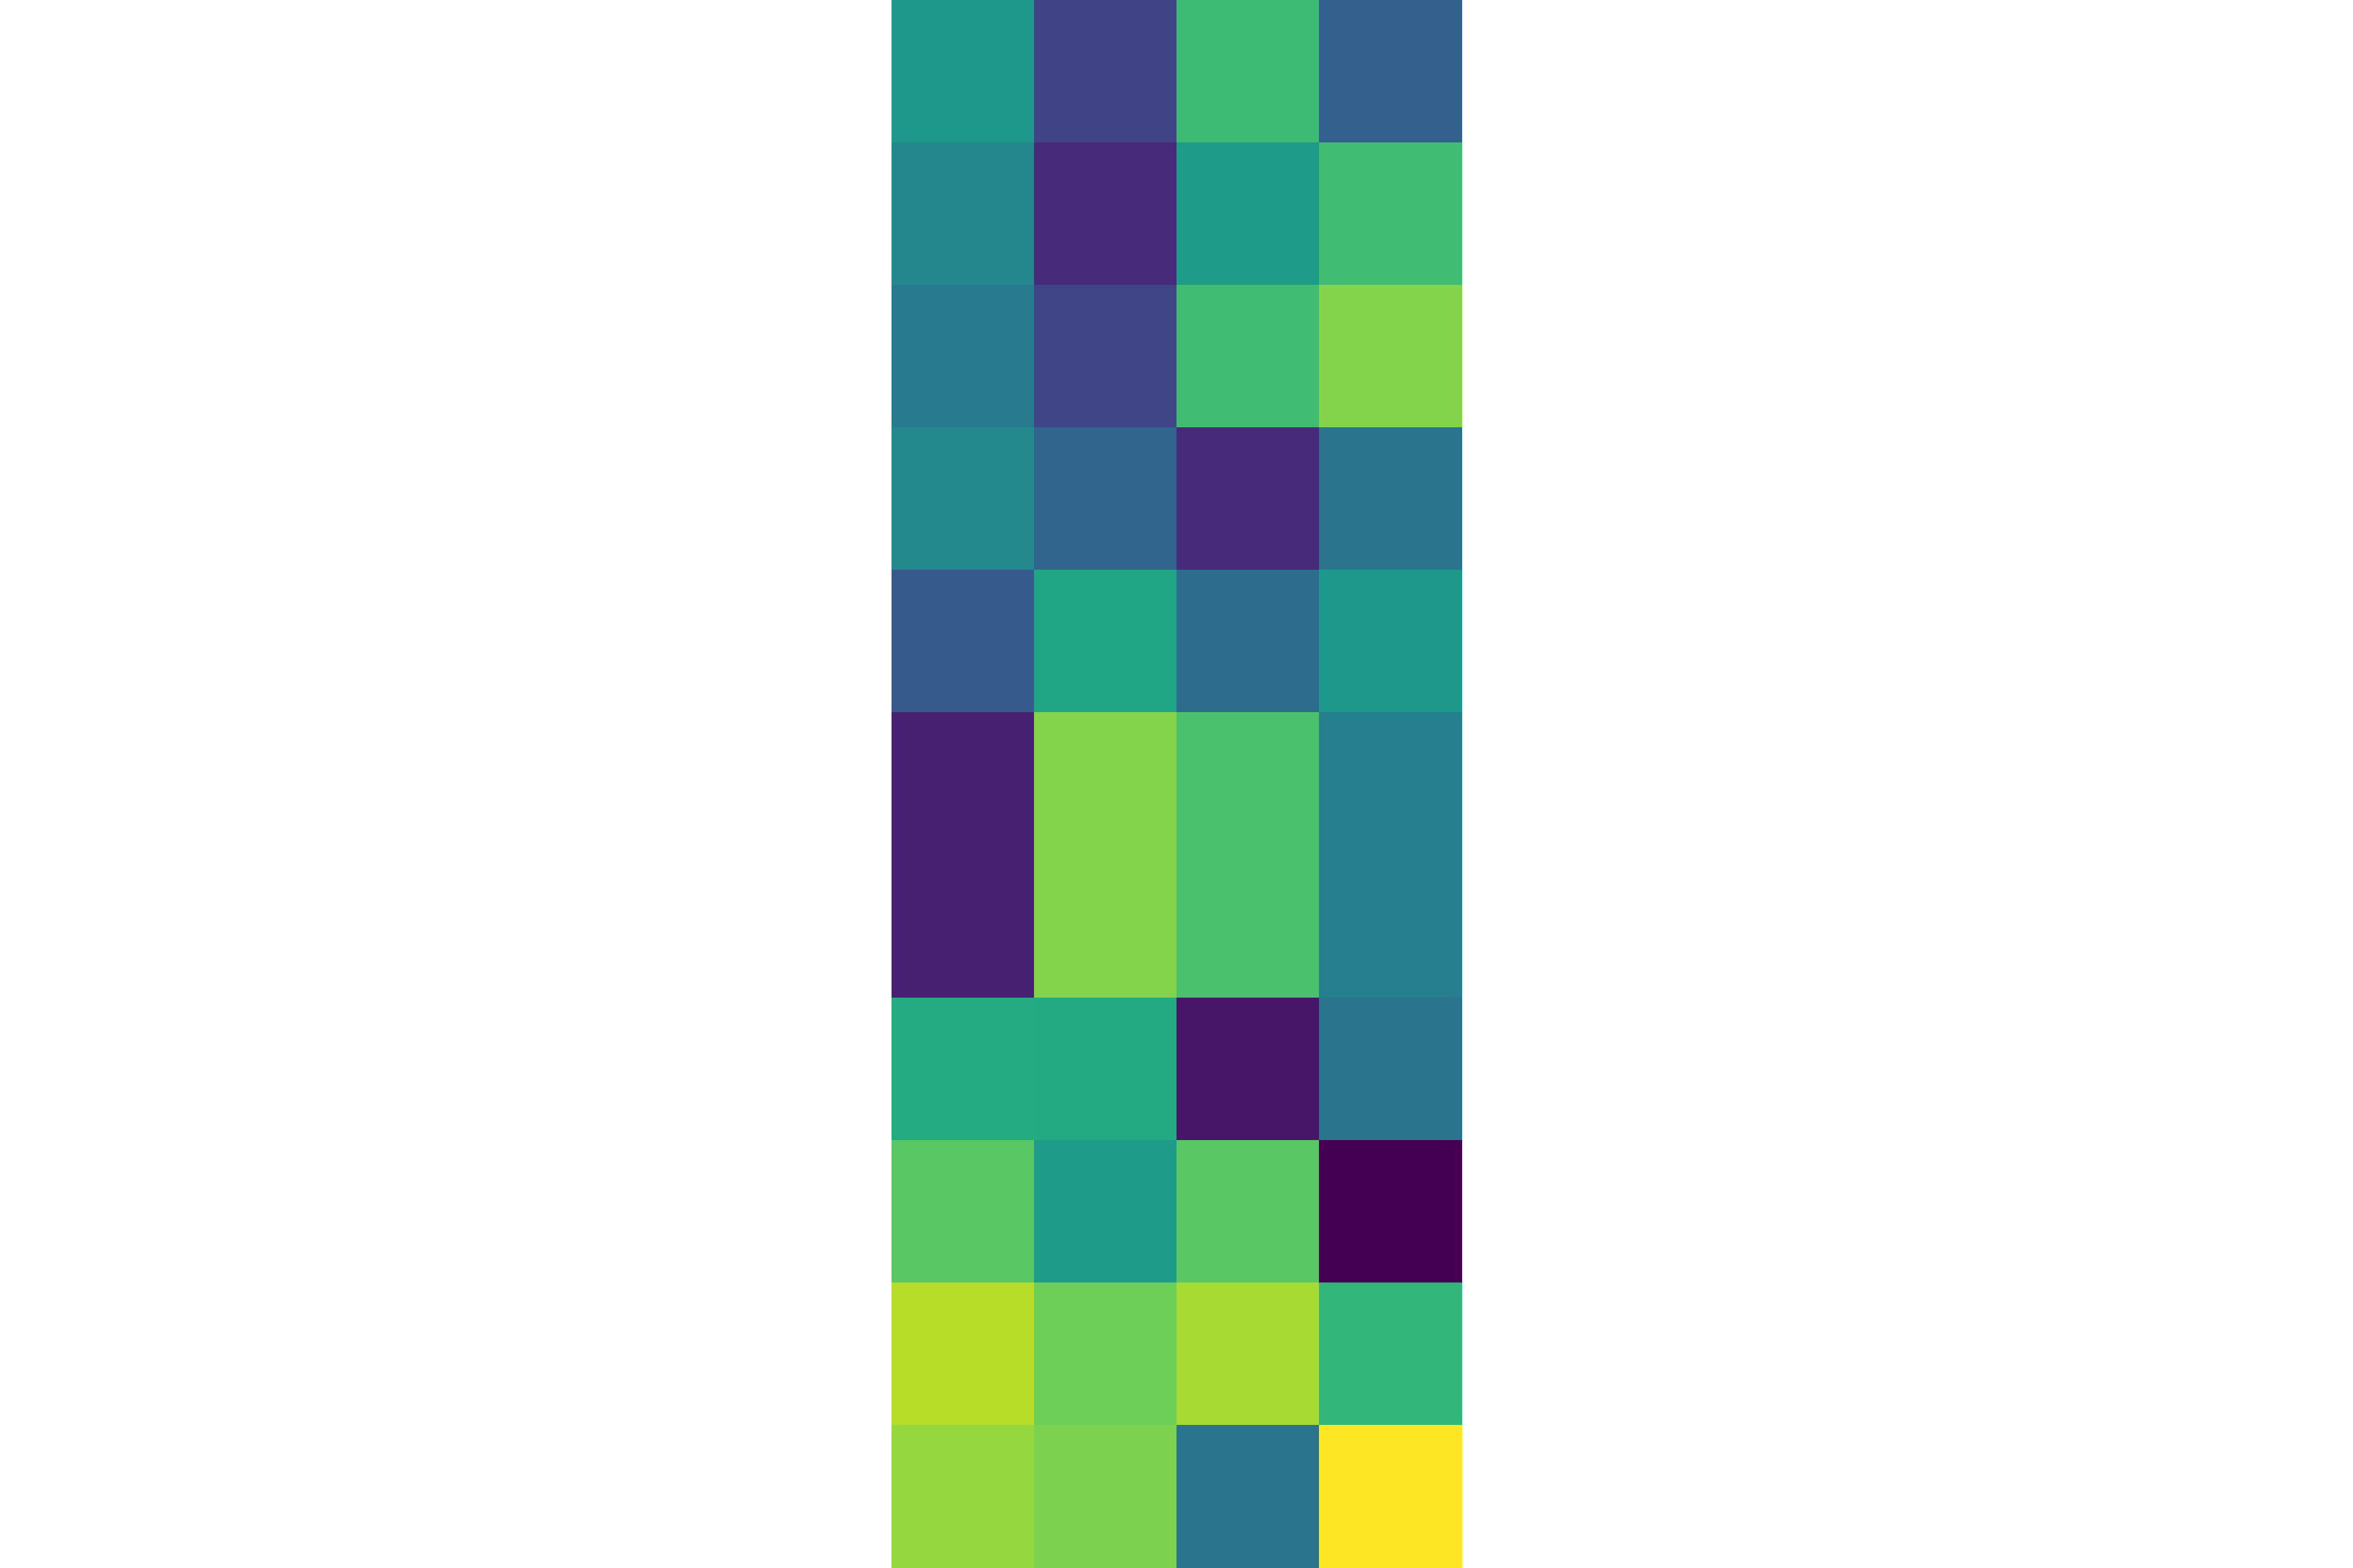




AROPE: algorithm overview
Do eigen decomposition on the adjacency matrix, scale the $λ$’s
Idea: $f\left(A\right)≈Qf\left(Λ\right)Q^{T}$, works with Katz similarity
$$Q$$
$$Λ$$
$$Q^{T}$$
Arbitrary-order proximity preserved network embedding. Zhang et al., KDD 2018

Slide 38
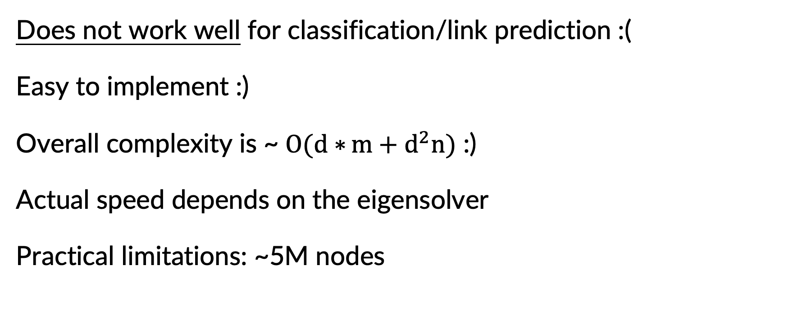
AROPE: asymptotics and practice
Does not work well for classification/link prediction :(
Easy to implement :)
Overall complexity is ~ $O(d∗{m+d^{2}n)}$ :)
Actual speed depends on the eigensolver
Practical limitations: ~5M nodes
Arbitrary-order proximity preserved network embedding. Zhang et al., KDD 2018

Slide 39
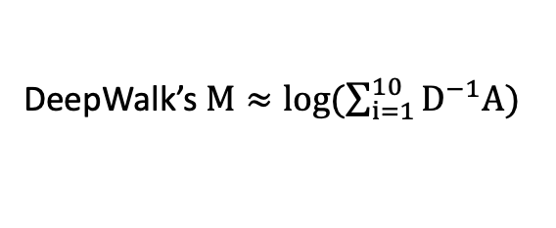
NetMF: algorithm overview
Let’s decompose DeepWalk’s similarity matrix
DeepWalk’s $M≈\log{(\sum_{i=1}^{10}{D^{−1}A)}}$
$$U$$
$$Σ$$
$$V^{T}$$
Network embedding as matrix factorization: Unifying DeepWalk, LINE, PTE, and node2vec. Qiu et al., WSDM 2018

Slide 40
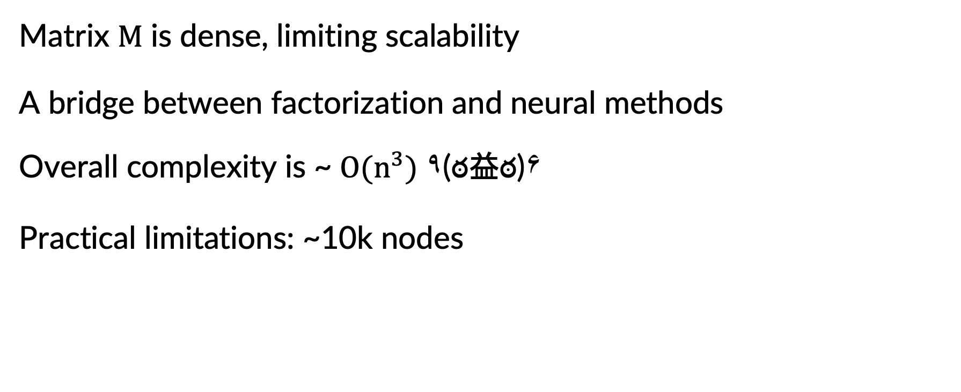
NetMF: asymptotics and practice
Matrix $M$ is dense, limiting scalability
A bridge between factorization and neural methods
Overall complexity is ~ $O(n^{3}{)}$ ٩(ఠ益ఠ)۶
Practical limitations: ~10k nodes
Arbitrary-order proximity preserved network embedding. Zhang et al., KDD 2018

Slide 41
Sketch-based embeddings

Slide 42
Anatomy of a sketch-based embedding
Iteratively approximate a higher-order embedding
$$U$$
$$Σ$$
[1] Billion-scale Network Embedding with Iterative Random Projection. Zhang et al., ICDM 2018
[2] Fast and Accurate Network Embeddings via Very Sparse Random Projection. Chen et al., CIKM 2018
[3] NodeSketch: Highly-Efficient Graph Embeddings via Recursive Sketching. Yang et al., KDD 2019

Slide 43


RandNE: algorithm overview
Approximate high-order $M$ by iterative random projections
1. Start with $U_{0}=QR(𝒩(0, \frac{1}{d}))$
$$U$$
2. Iteratively set$U_{i}=A∗U_{i−1}$
3. Final embedding is a weighted sum $U=α_{0}U_{0}+α_{1}U_{1}+…$
Billion-scale Network Embedding with Iterative Random Projection. Zhang et al., ICDM 2018

Slide 44
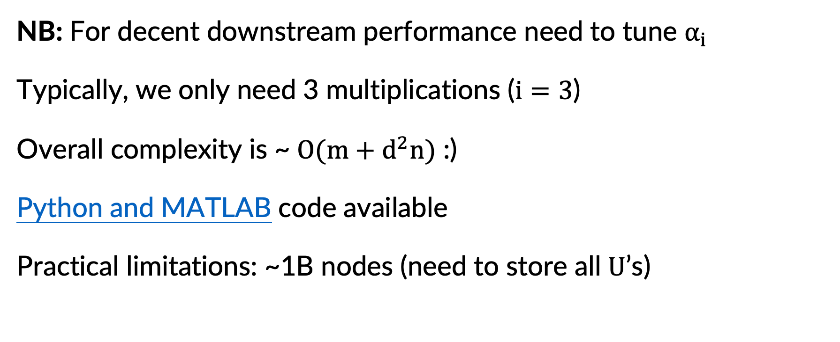
RandNE: asymptotics and practice
NB: For decent downstream performance need to tune $α_{i}$
Typically, we only need 3 multiplications ($i=3$)
Overall complexity is ~ $O(m+d^{2}n{)}$ :)
Python and MATLAB code available
Practical limitations: ~1B nodes (need to store all $U$’s)
Billion-scale Network Embedding with Iterative Random Projection. Zhang et al., ICDM 2018

Slide 45
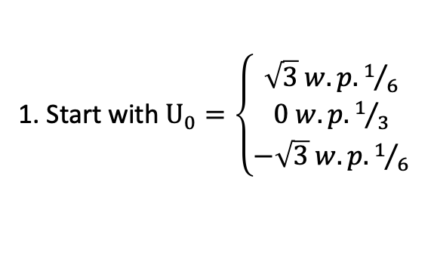
FastRP: algorithm overview
Approximate high-order $M$ by iterative random projections
1. Start with $U_{0}=\left\{\begin{aligned}\sqrt{3} w.p. 1/6 \\ 0 w.p. 1/3 \\ −\sqrt{3} w.p. 1/6\end{aligned}\right.$
$$U$$
2. Iteratively set$U_{i}=A∗L∗U_{i−1}$, $L$ $≈$degree normalization
3. Final embedding is a weighted sum $U=α_{0}U_{0}+α_{1}U_{1}+…$
Fast and Accurate Network Embeddings via Very Sparse Random Projection. Chen et al., CIKM 2018

Slide 46
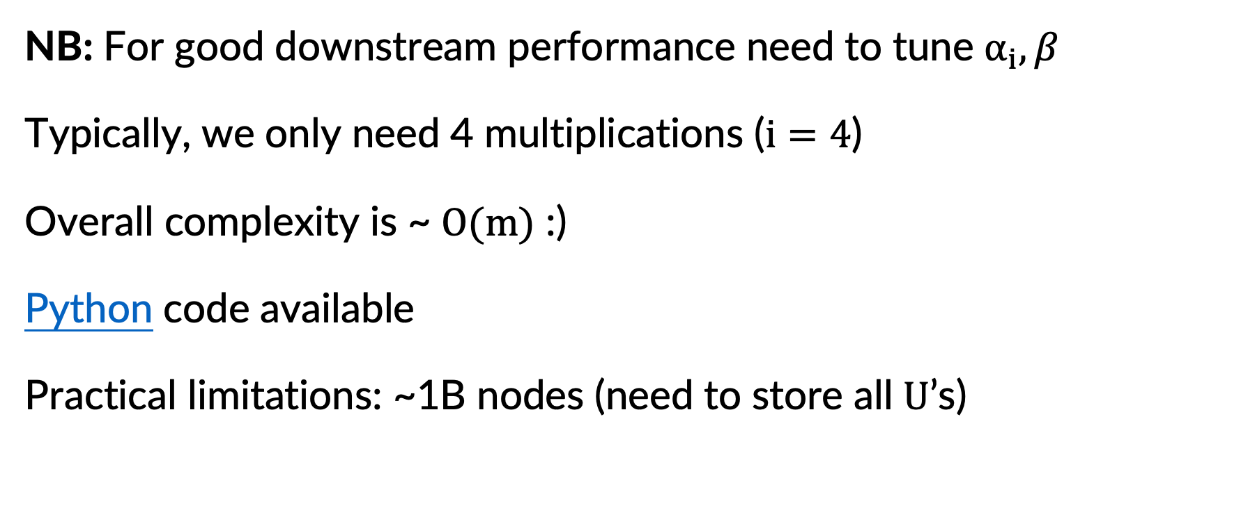
FastRP: asymptotics and practice
NB: For good downstream performance need to tune $α_{i}, β$
Typically, we only need 4 multiplications ($i=4$)
Overall complexity is ~ $O(m{)}$ :)
Python code available
Practical limitations: ~1B nodes (need to store all $U$’s)
Billion-scale Network Embedding with Iterative Random Projection. Zhang et al., ICDM 2018

Slide 47



NodeSketch: algorithm overview
Approximate high-order $M$ by iterative sketching
1. Start with $U_{0}=$sketch(A+I)
$$U$$
2. Iteratively sketch$U_{i}=sketch(α∗A∗U_{i−1})$
3. Final embedding is simply $U_{k}$
NodeSketch: Highly-Efficient Graph Embeddings via Recursive Sketching. Yang et al., KDD 2019

Slide 48
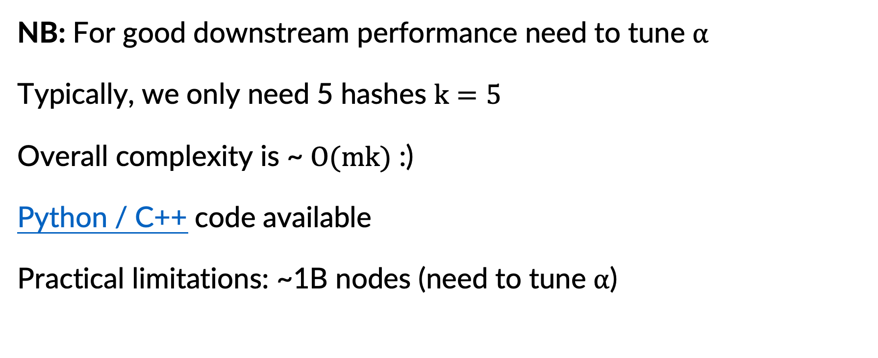
FastRP: asymptotics and practice
NB: For good downstream performance need to tune $α$
Typically, we only need 5 hashes $k=5$
Overall complexity is ~ $O(mk{)}$ :)
Python / C++ code available
Practical limitations: ~1B nodes (need to tune $α$)
NodeSketch: Highly-Efficient Graph Embeddings via Recursive Sketching. Yang et al., KDD 2019

Slide 49
Choosing the right algorithm
Start
N<10k
Yes
NetMF
No
N<1M
Yes
DeepWalk*, VERSE
No
RandNE, FastRP, NodeSketch

Slide 50
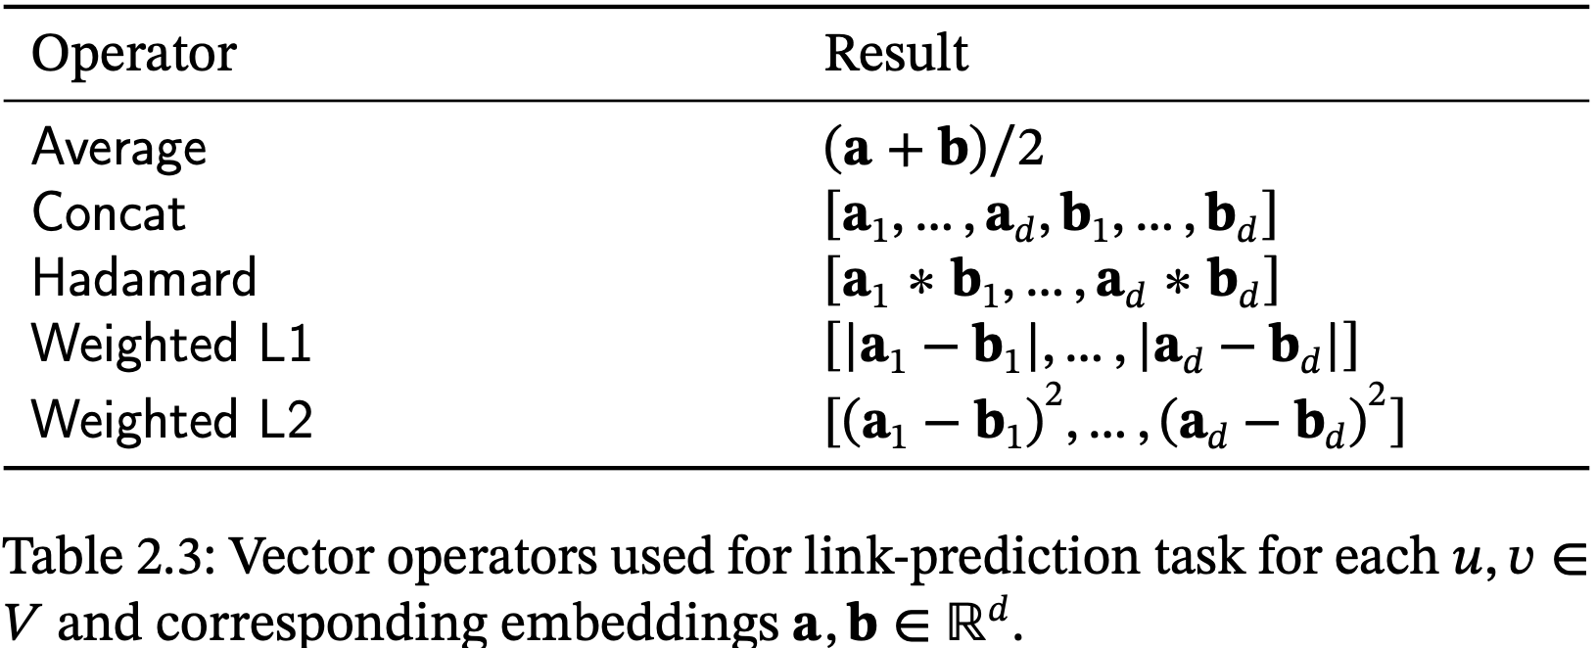
Edge embeddings
NB: choose operator depending on the algorithm

Slide 51
Questions?
twitter twitter.com/tsitsulin_
website tsitsul.in/talks/ods ← presentation
write me anton@tsitsul.in

