Slide 1
Similarities and Representations of Graphs
Anton Tsitsulin
Hasso Plattner Institute → University of Bonn

Slide 2
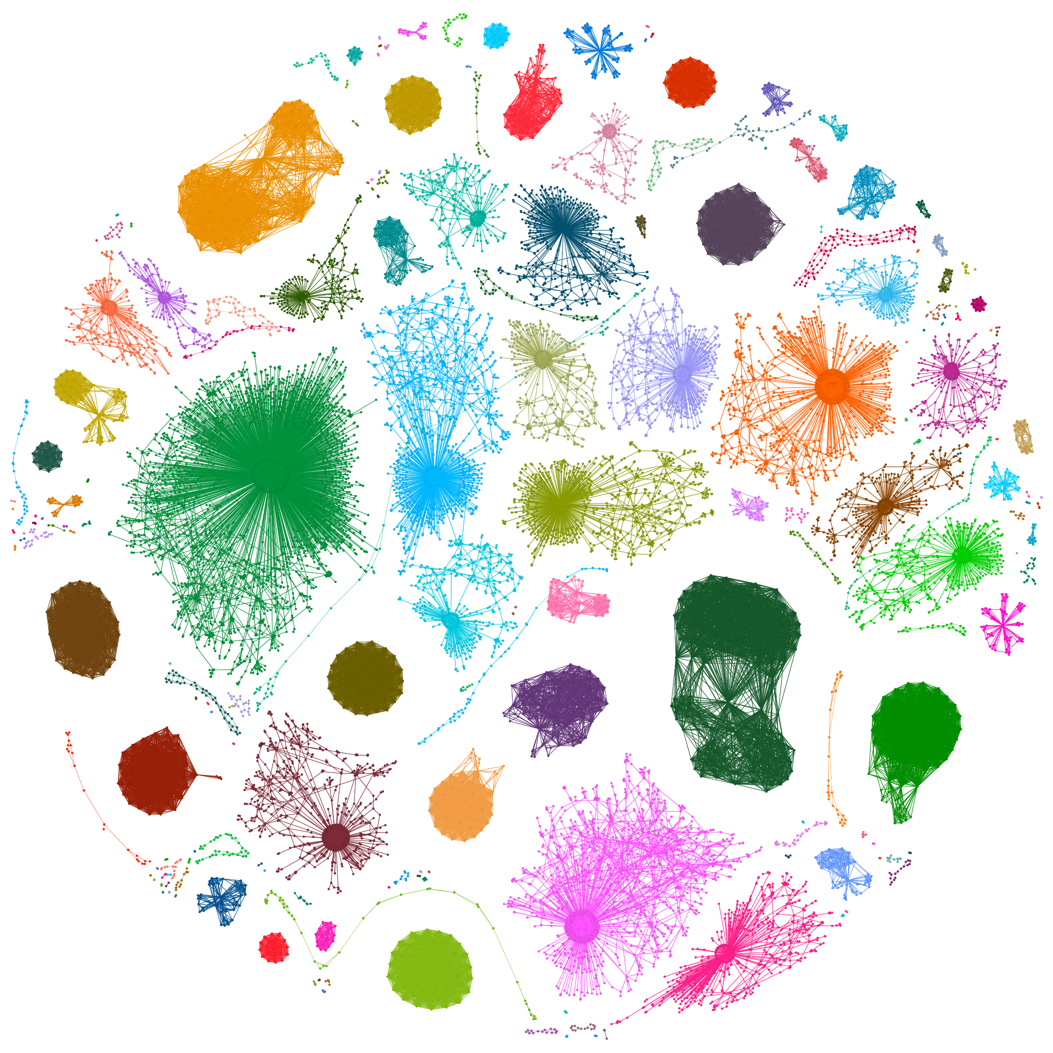
Graph world is diverse
Different domains:
  Information
  Social
  Biological
  Transportation
  …

Slide 3
Graph world is diverse
Different graph types:
  (Un)directed
  (Un)weighted
  Temporal
  Heterogeneous
  …

Slide 4
Graph world is diverse
Different modalities:
  Nodes
  Edges
  Motifs
  Subgraphs
  Whole graphs
  …

Slide 5
Graph world is diverse
Different tasks:
  Classification
  Clustering
  Anomaly detection
  …

Slide 6
Graph world is diverse
Domains
  Information
  Social
  Biological
  Transportation
Graph Types
  (Un)directed
  (Un)weighted
  Temporal
  Heterogeneous
Modalities
  Nodes
  Edges
  Subgraphs
  Whole graphs
Tasks
  Classification
  Clustering
  Anomaly detection

Slide 7
Graph world is diverse
Domains
  Information
  Social
  Biological
  Transportation
Graph Types
  (Un)directed
  (Un)weighted
  Temporal
  Heterogeneous
Modalities
  Nodes
  Edges
  Subgraphs
  Whole graphs
Tasks
  Classification
  Clustering
  Anomaly detection
  ↓
  Embeddings

Slide 8
Why representations?
We have fast & good algorithms for mining vector data…
Clustering

Slide 9
Why representations?
We have fast & good algorithms for mining vector data…
Clustering

Slide 10

Why representations?
We have fast & good algorithms for mining vector data…
low-dimensional representation
Clustering

Slide 11
Why representations?
We have fast & good algorithms for mining vector data…
low-dimensional representation
k-means
Clustering

Slide 12
Why representations?
We have fast & good algorithms for mining vector data…
Classification

Slide 13
Why representations?
We have fast & good algorithms for mining vector data…
Classification

Slide 14
Why representations?
We have fast & good algorithms for mining vector data…
low-dimensional representation
Classification

Slide 15
Why representations?
We have fast & good algorithms for mining vector data…
low-dimensional representation
Log. regression
Classification

Slide 16
Why representations?
We have fast & good algorithms for mining vector data…
low-dimensional representation
Log. regression
Classification

Slide 17
What makes a Representation?
Good representation preserves geometry of the original space.

Slide 18
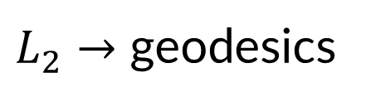
What makes a Representation?
Good representation preserves geometry of the original space.
Representations
Similarities
$L_{2}→$ geodesics

Slide 19
What makes a Representation?
Good representation preserves geometry of the original space.
Factorization, NNs, …
Representations
Similarities
$L_{2}→$ geodesics

Slide 20


Part I: node representations
VERSE: Versatile Graph Embeddings
from Similarity Measures
Anton Tsitsulin¹ Davide Mottin¹ Panagiotis Karras² Emmanuel Müller¹
¹
²
Notes:
;-)

Slide 21
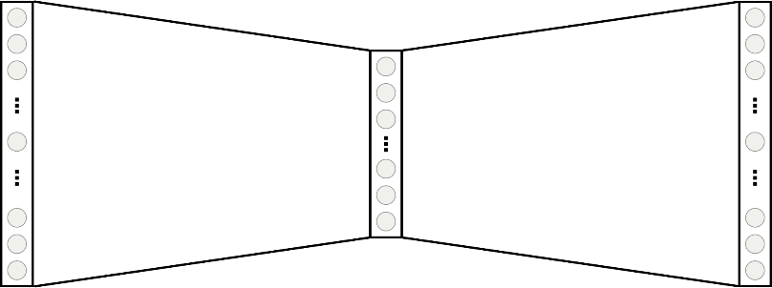


Neural node representations
Nodes in random walks $≈$ words in sentences $→$ word2vec
Random walks^{[2,3]}
Self-supervised neural network^{[1]}
$$W$$
$$W^{T}$$
representation
[1] Efficient Estimation of Word Representations in Vector Space, Mikolov et al., NIPS 2013
[2] DeepWalk: Online Learning of Social Representations, Perozzi et al., KDD 2014
[3] node2vec: Scalable Feature Learning for Networks, Grover & Leskovec, KDD 2016

Slide 22
Wait, what?
Do we know what do these walks mean?
  What do parameters change?
  What does the model optimize?
word2vec can be understood as matrix factorization!
[1] Metric recovery from directed unweighted graphs, Hashimoto et al., AISTATS 2015
[2] Neural Word Embedding as Implicit Matrix Factorization , Levy & Goldberg, NIPS 2014

Slide 23
Wait, what?
Do we know what do these walks mean?
  What do parameters change?
  What does the model optimize?
word2vec can be understood as matrix factorization!
Yes, but the assumptions are too strict!
(dimensionality = number of nodes)
[1] Metric recovery from directed unweighted graphs, Hashimoto et al., AISTATS 2015
[2] Neural Word Embedding as Implicit Matrix Factorization , Levy & Goldberg, NIPS 2014

Slide 24
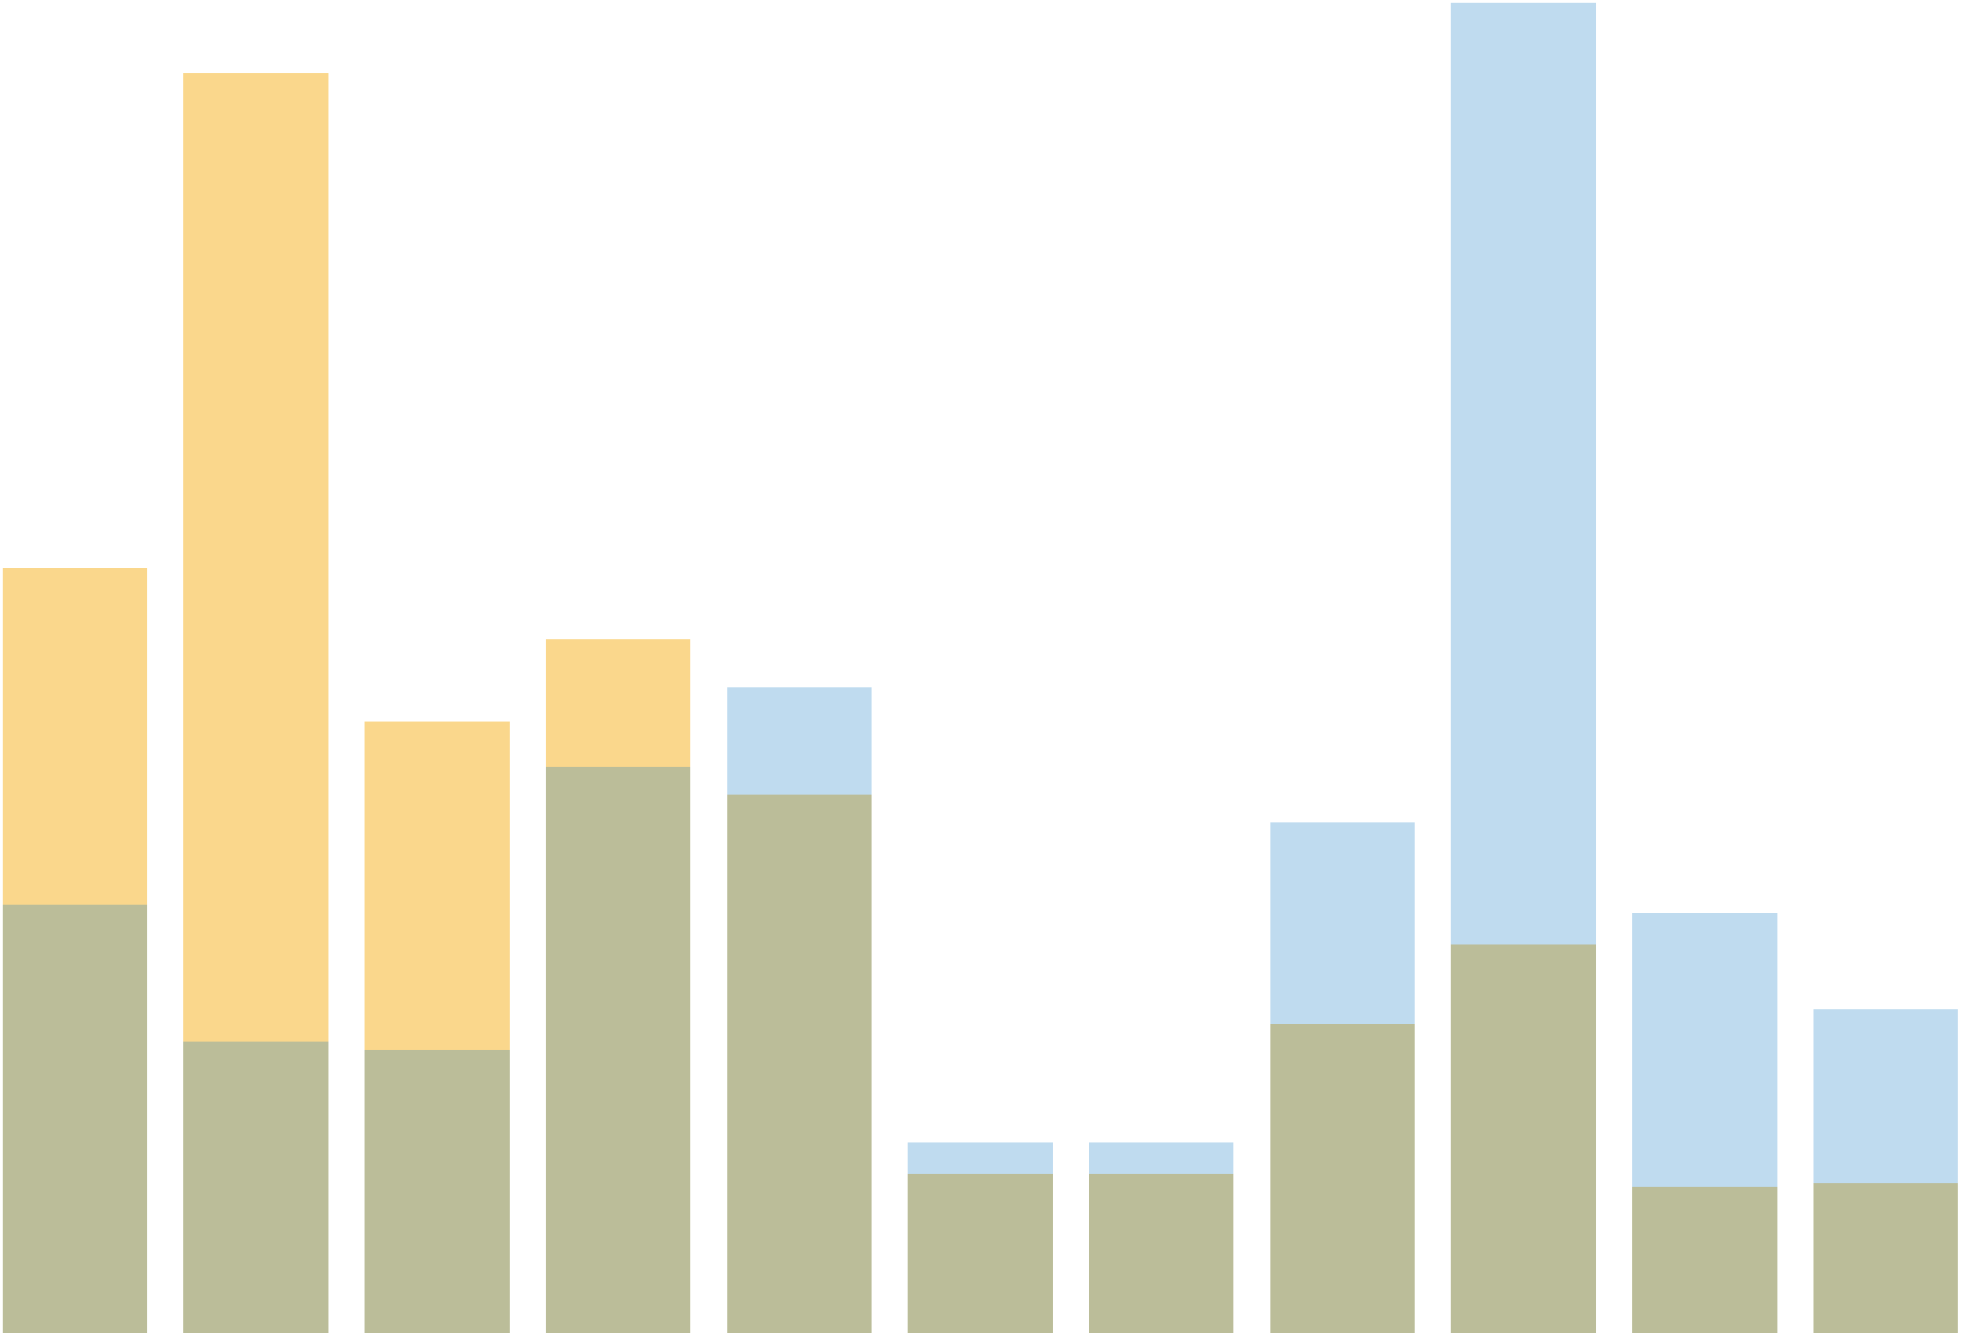






Key observation
Random walks define node similarity distributions!
Random walks converge to Personalized PageRank
$sim(u,⋅)$
$sim(v,⋅)$
$$u$$
$$v$$
$$u$$
$$v$$

Slide 25
Key observation
Random walks define node similarity distributions!
Random walks converge to Personalized PageRank
$sim(u,⋅)$
$sim(v,⋅)$
$$u$$
$$v$$
$$u$$
$$v$$
Q: Can we inject similarities fully into the model?

Slide 26
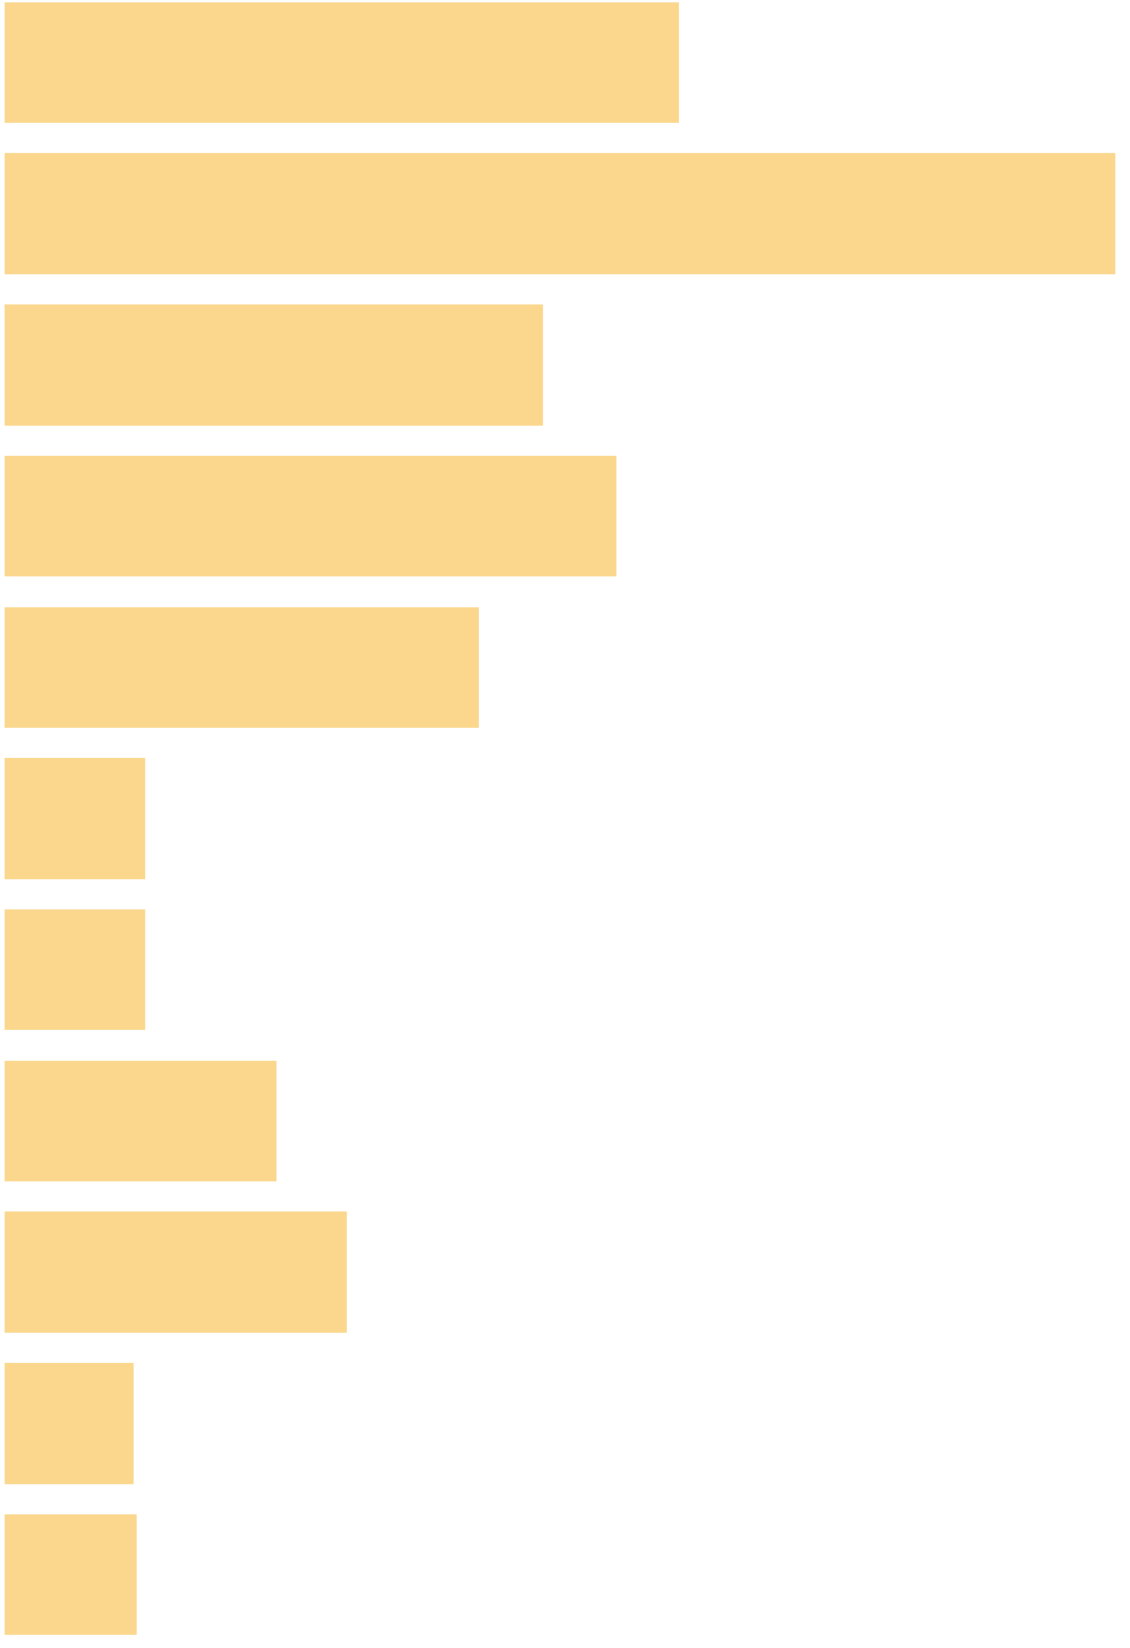


Yes, we can!
VERSE can learn similarity distributions
$$u$$
Self-supervised neural network^{[1]}
Node similarities
$$u$$
$$W$$
$$W^{T}$$
representation
Q1: Which similarities can we possibly represent?
Q2: What other methods have to do with similarities?

Slide 27
Why similarities?
We can explicitly measure the quality

Slide 28
Why similarities?
We can measure the quality
We can adapt the similarity to the data/task
  Examples in the paper: PageRank, SimRank, adjacency

Slide 29
Why similarities?
We can measure the quality
We can adapt the similarity to the data/task
  Examples in the paper: PageRank, SimRank, adjacency
Thinking about similarities provides insight:
  We show how DeepWalk & node2vec ≈ PPR
  VERSE uses 1 parameter instead of 5

Slide 30
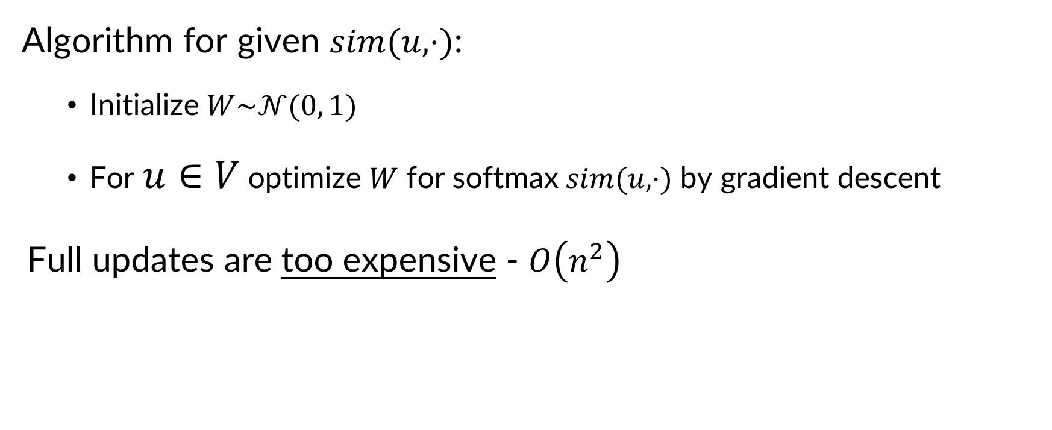



VERSE graph embedding
Algorithm for given $sim(u,⋅)$:
  Initialize $W\sim 𝒩(0, 1)$
  For $u∈V$ optimize $W$ for softmax$sim(u,⋅)$ by gradient descent
Full updates are too expensive - $O\left(n^{2}\right)$
$sim(u,⋅)$
$$W$$
$$W^{T}$$
We make it faster via sampling!
representation

Slide 31
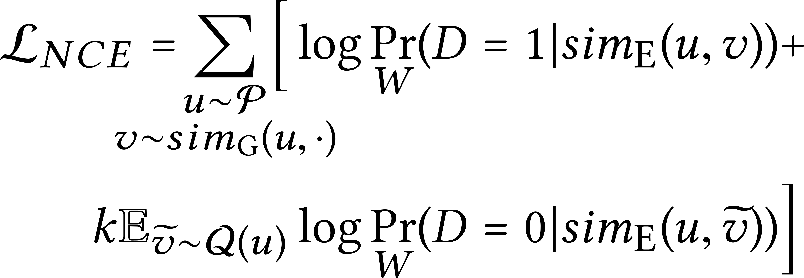
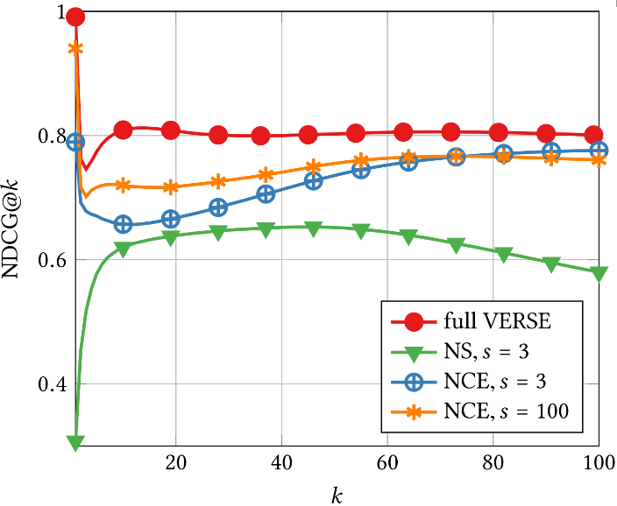
Sampling in VERSE
We use Noise Contrastive Estimation
Negative Sampling does not preserve similarities!

Slide 32
Experimental setup
Goal: diverse tasks & datasets
PPR as default similarity
Max. one day on 10-core server (try that at home!)
Code @ GitHub, C for performance (don’t try that at home!)

Slide 33
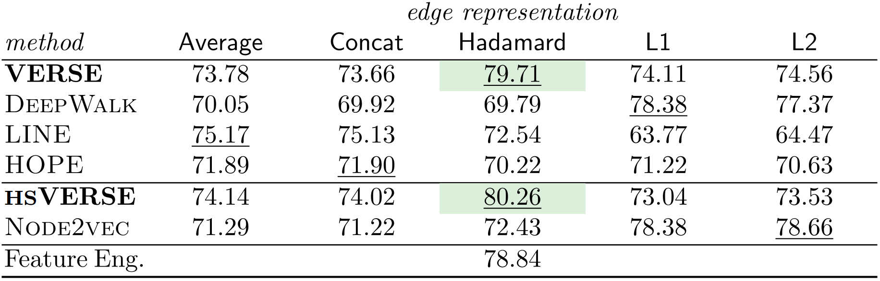

Social graph $×$ link prediction
Link prediction
(accuracy)

Slide 34
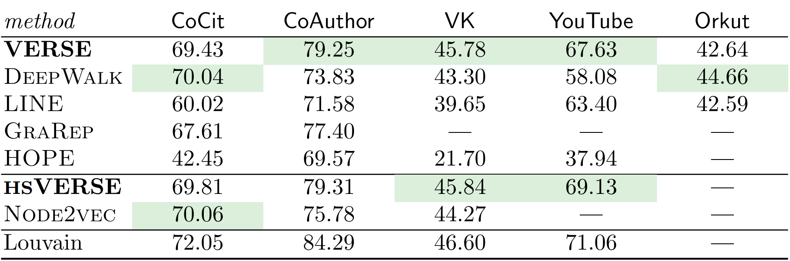
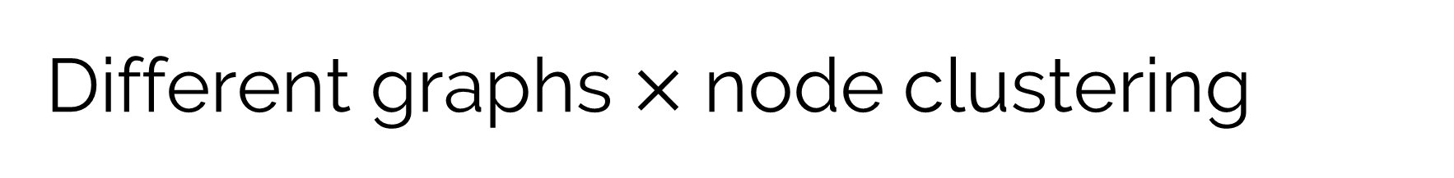
Different graphs $×$ node clustering
Node clustering
(modularity)

Slide 35
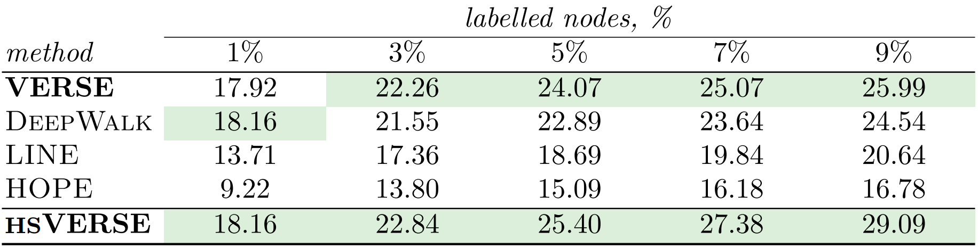

Web graph $×$ node classification
Classification
(accuracy)

Slide 36
Take home messages
We provide new useful abstraction: node similarities
We create VERSE to explicitly work with similarities
We develop a scalable approximation technique with NCE
There is a room for improvement!

Slide 37



Part II: graph representations
NetLSD: Hearing the Shape of a Graph
Anton Tsitsulin¹ Davide Mottin¹ Panagiotis Karras²
Alex Bronstein³ Emmanuel Müller¹
¹ HPI
Germany
² Aarhus university
Denmark
³ Technion
Israel
Notes:
;-)

Slide 38
Defining graph similarity
With it, we can do:
  Classification
  Clustering
  Anomaly detection
  …

Slide 39
Scalability is key!
Two problem sources:
  Big graphs
  Many graphs
Solution: graph descriptors

Slide 40
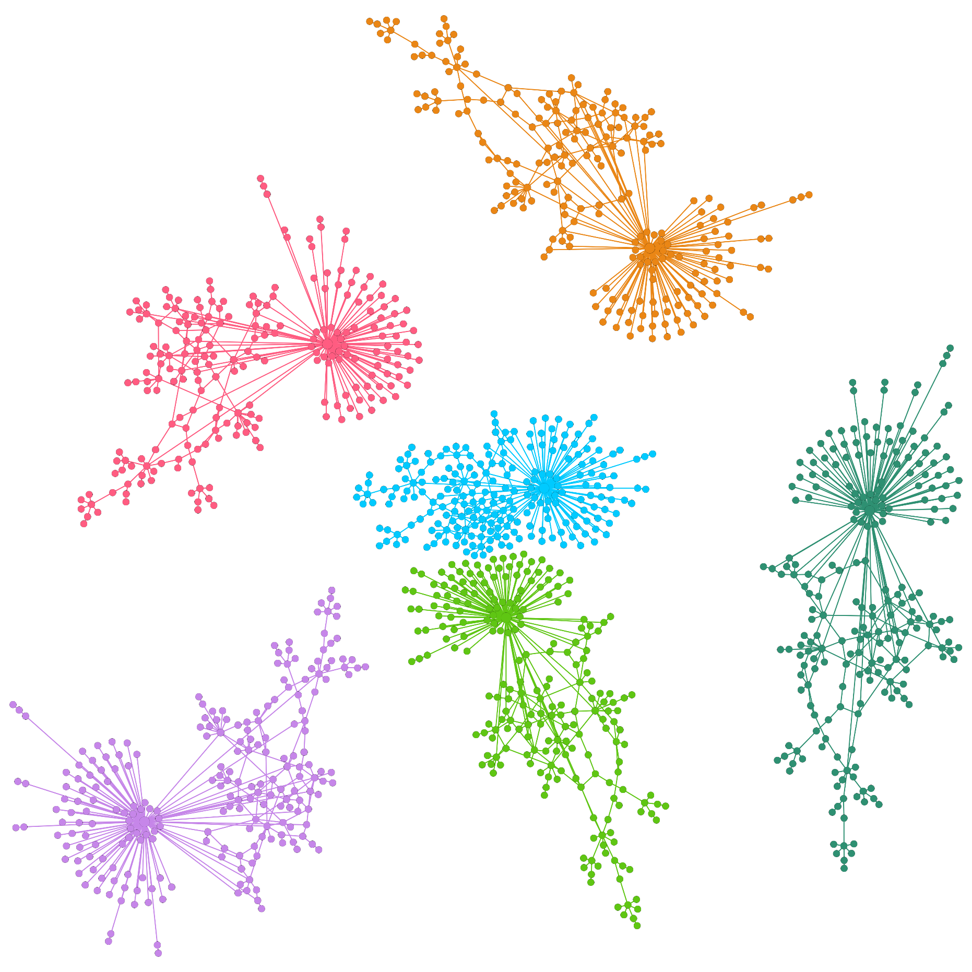

Isomorphism $⇒d\left(G_{1},G_{2}\right)=0$
3 key properties:
  Permutation invariance
  Scale-adaptivity
  Size invariance

Slide 41
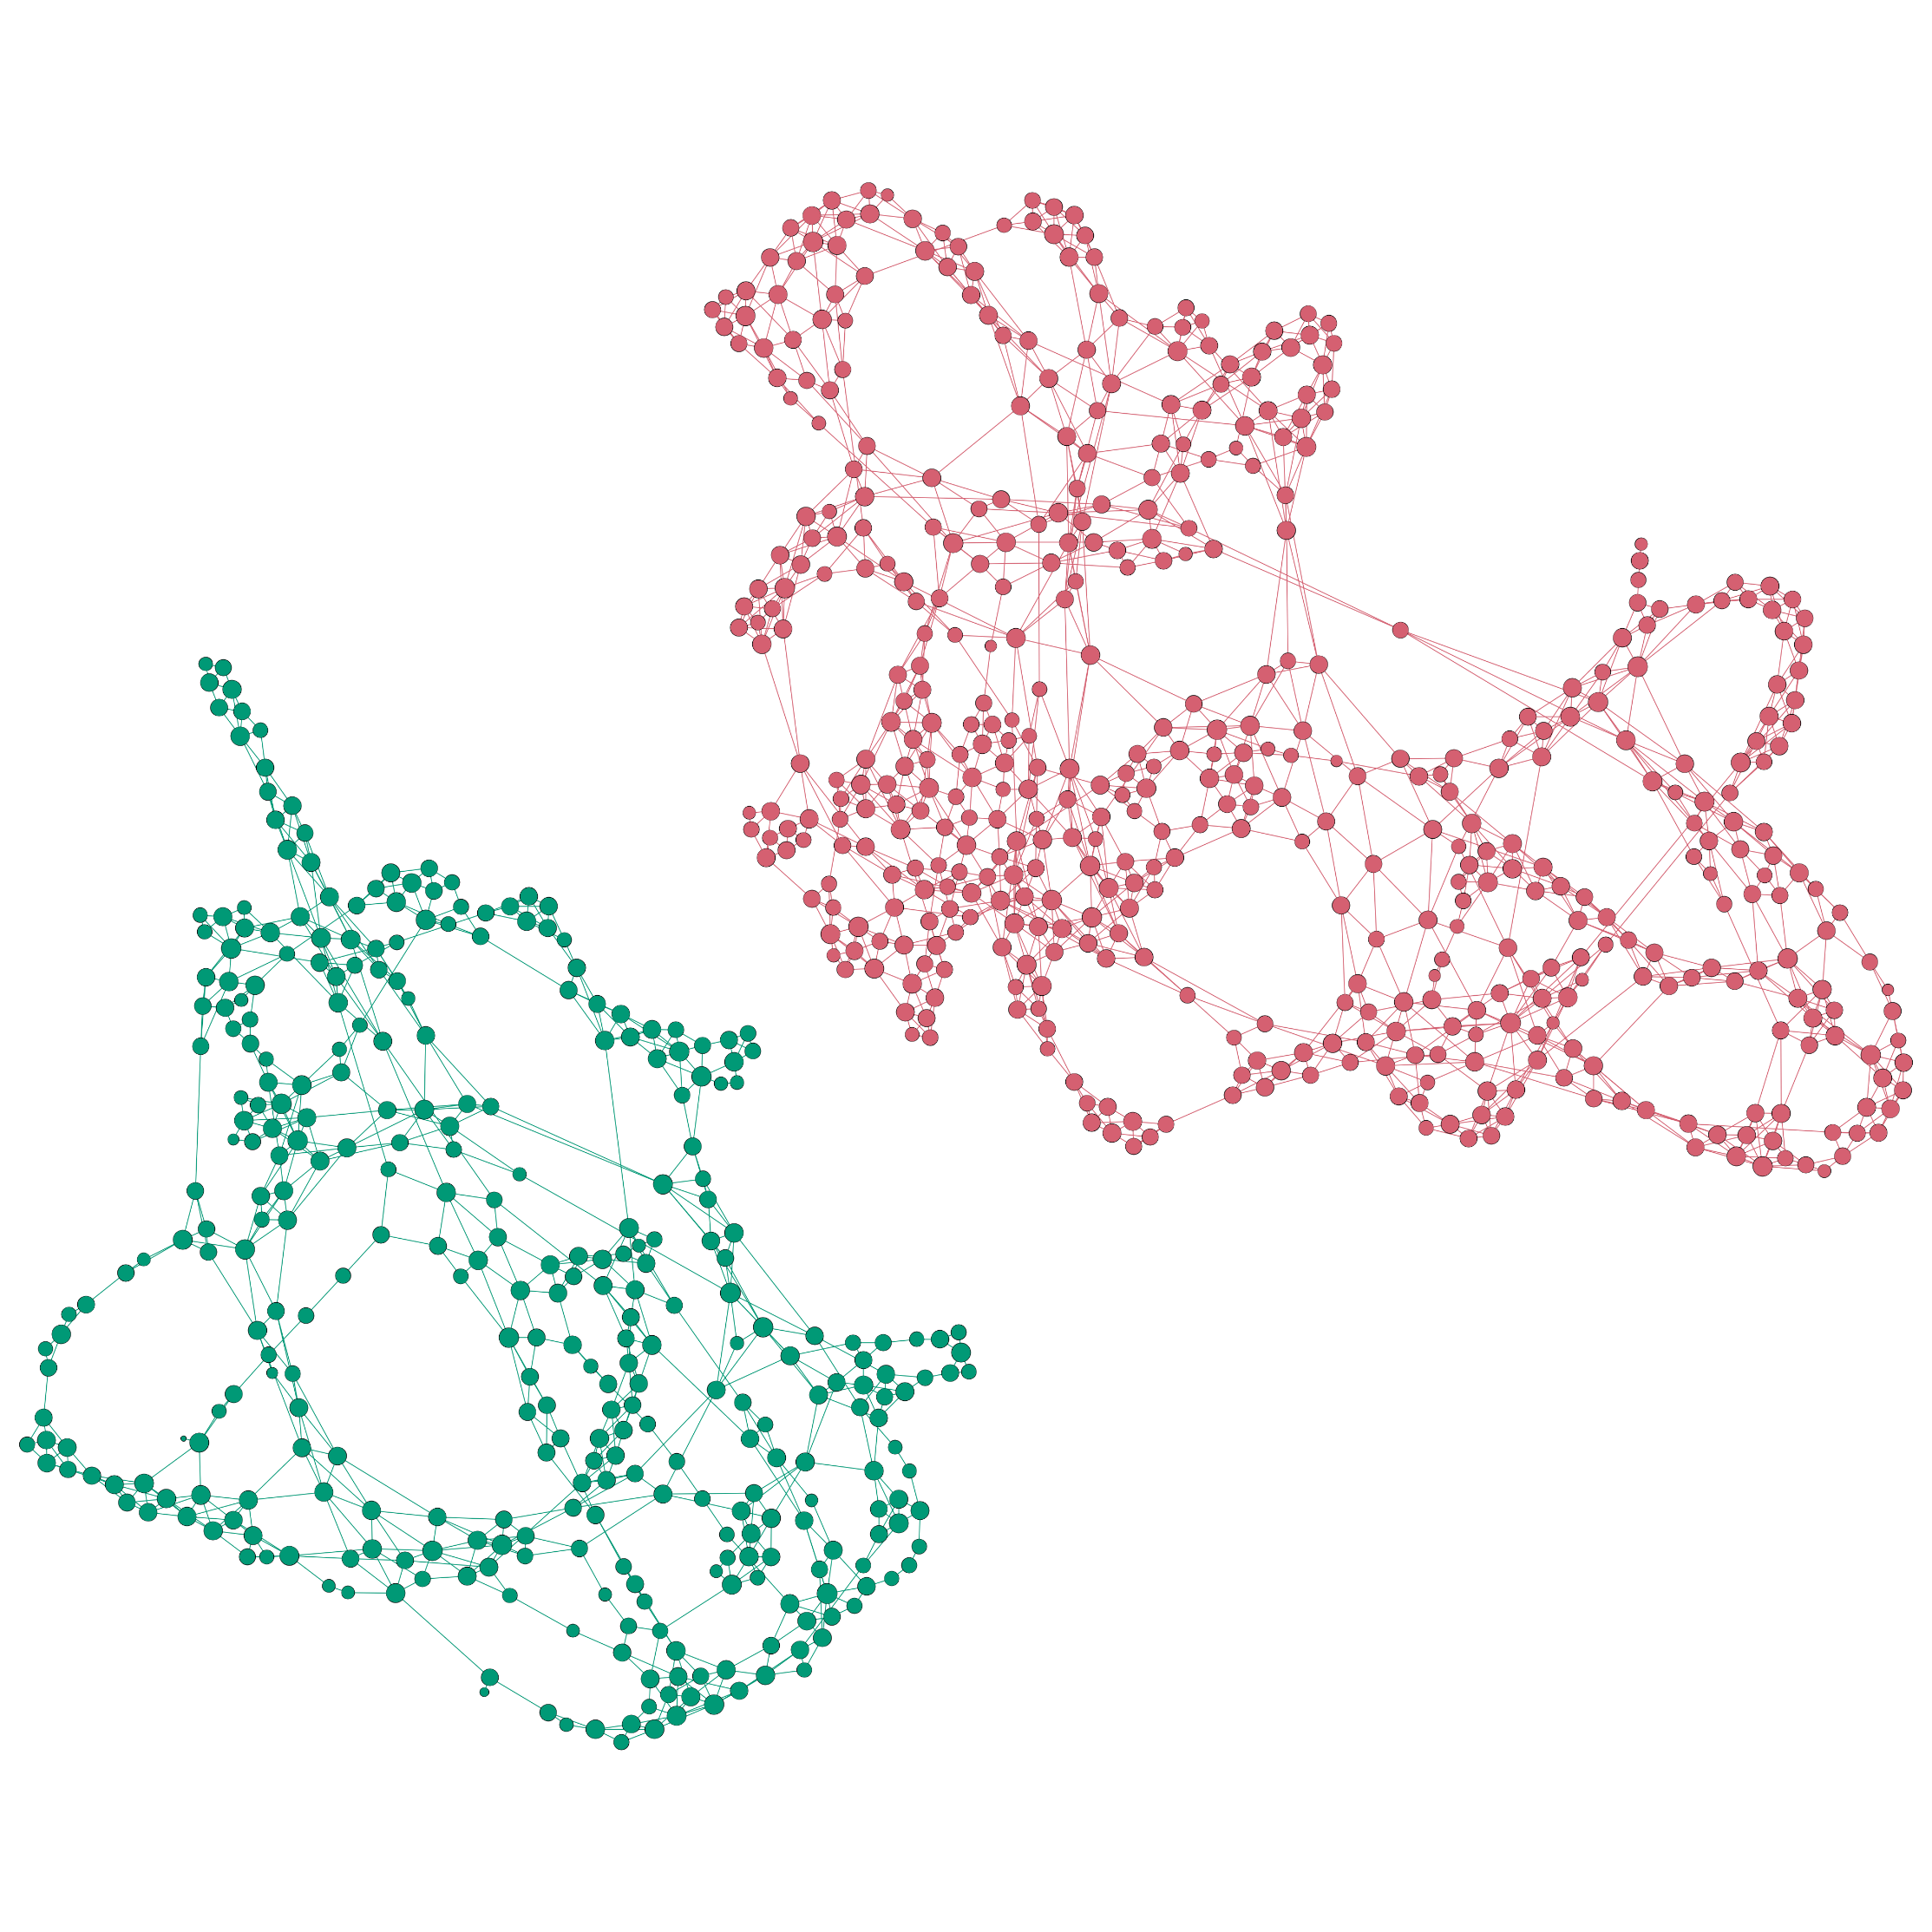
Local structures are important
3 key properties:
  Permutation invariance
  Scale-adaptivity
  Size invariance

Slide 42
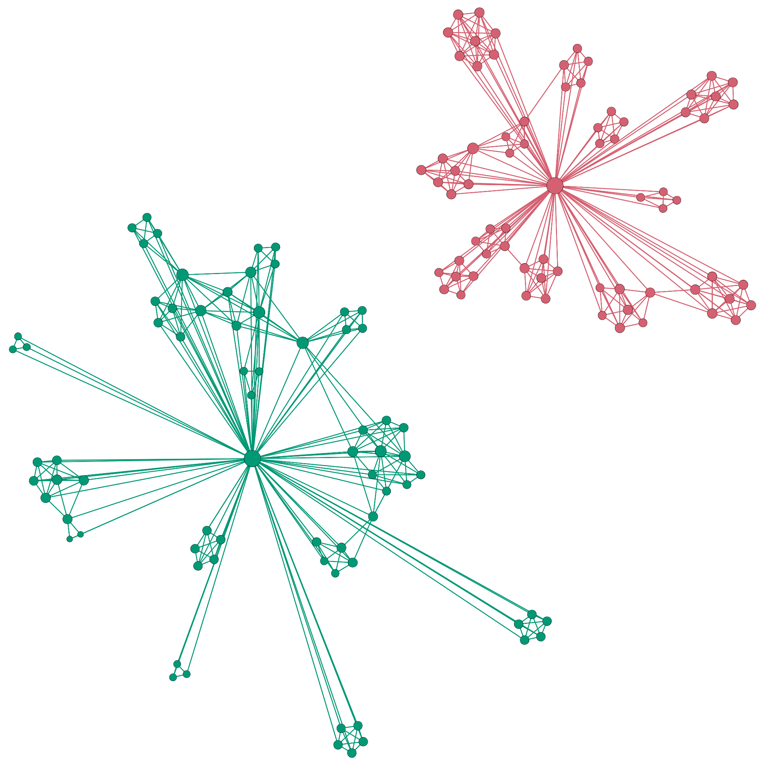
Global structure is important
3 key properties:
  Permutation invariance
  Scale-adaptivity
  Size invariance

Slide 43
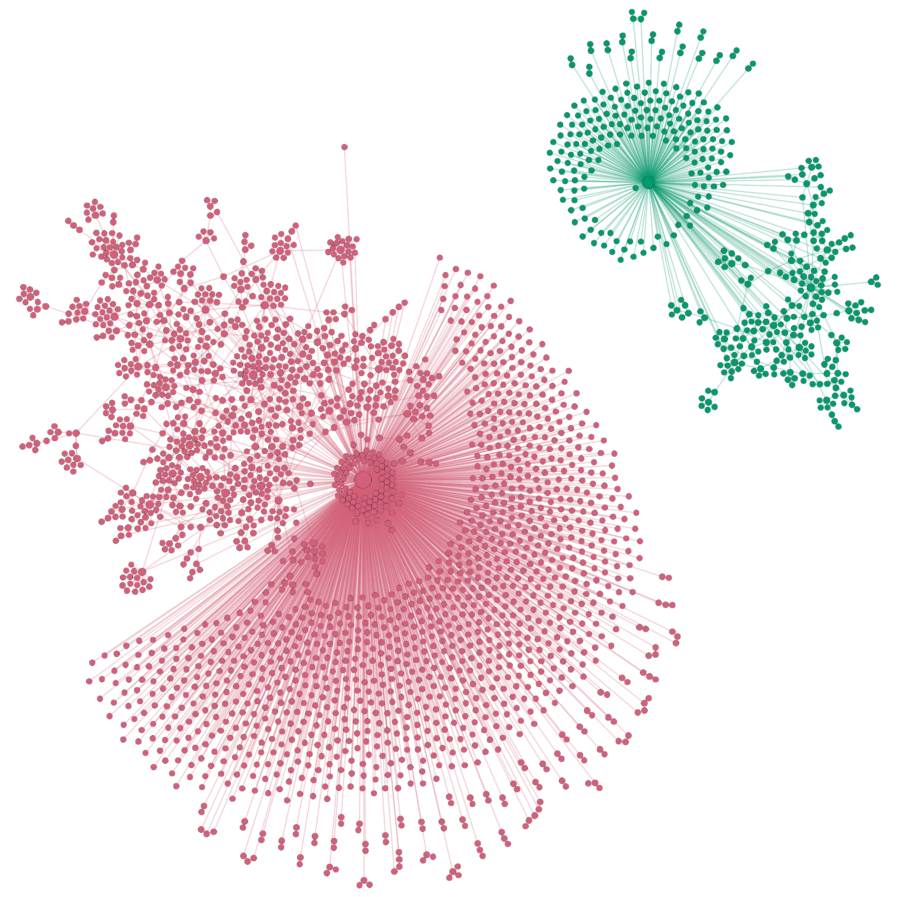
We may need to disregard the size
3 key properties:
  Permutation invariance
  Scale-adaptivity
  Size invariance

Slide 44
Network Laplacian Spectral Descriptors
3 key properties:
  Permutation invariance
  Scale-adaptivity
  Size invariance
+ Scalability
= NetLSD

Slide 45
Optimal Transport
Geometry for probability measures supported on a space.

Slide 46
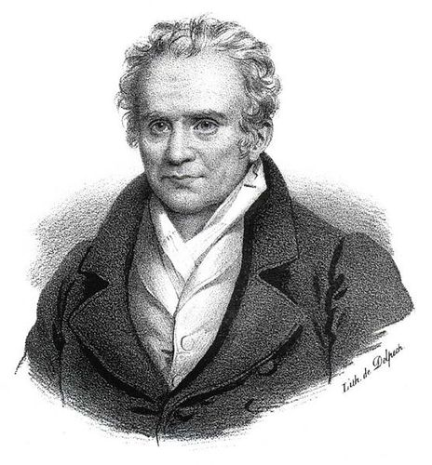
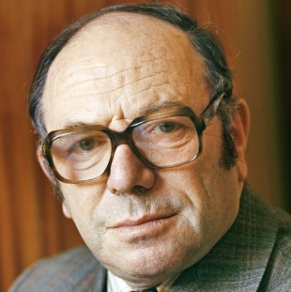
Optimal Transport
Geometry for probability measures supported on a space.
G. Monge
1781
L. Kantorovich
1939
Notes:
“When one has to bring earth from one place to another..” – Monge 1781

Slide 47

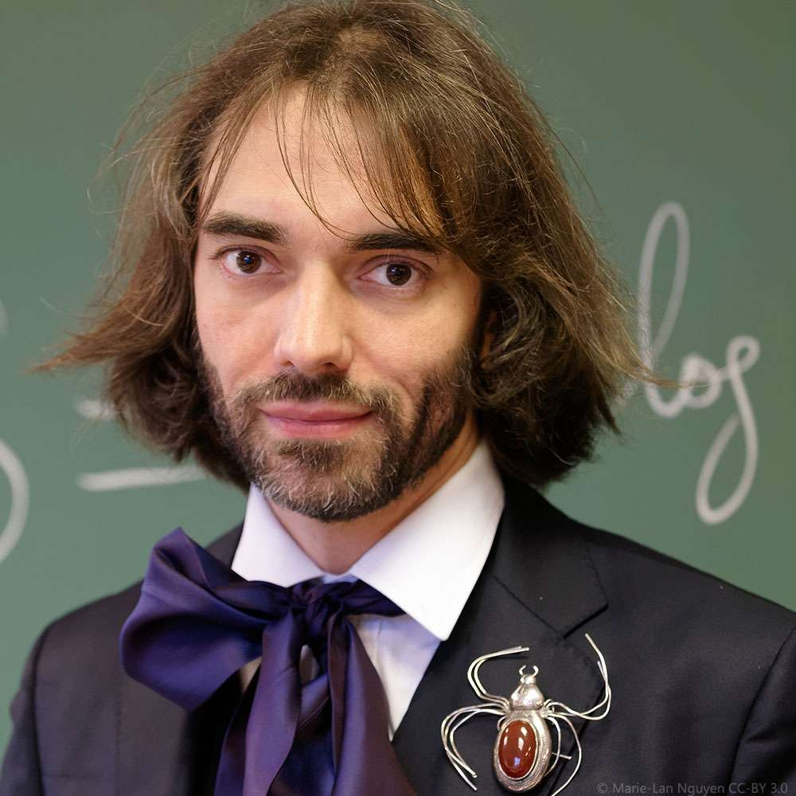
Optimal Transport
Geometry for probability measures supported on a space.
G. Monge
1781
L. Kantorovich
1939
C. Villani
2003
Notes:
“When one has to bring earth from one place to another..” – Monge 1781

Slide 48


Optimal Transport
Geometry for probability measures supported on a space.
G. Monge
1781
L. Kantorovich
1939
$$μ$$
$$ν$$
Notes:
“When one has to bring earth from one place to another..” – Monge 1781

Slide 49
Optimal Transport
Geometry for probability measures supported on a space.
G. Monge
1781
L. Kantorovich
1939
$$μ$$
$$ν$$
Notes:
“When one has to bring earth from one place to another..” – Monge 1781

Slide 50
Optimal Transport
Geometry for probability measures supported on a space.
G. Monge
1781
L. Kantorovich
1939
Discrete case → Linear programming
$$ν$$
Notes:
“When one has to bring earth from one place to another..” – Monge 1781

Slide 51


Gromov-Wasserstein distance
$$X$$
$$Y$$

Slide 52
Gromov-Wasserstein distance
$$X$$
$$Y$$

Slide 53


Gromov-Wasserstein distance
$$d$$
$$\overline{d}$$
$$X$$
$$Y$$

Slide 54
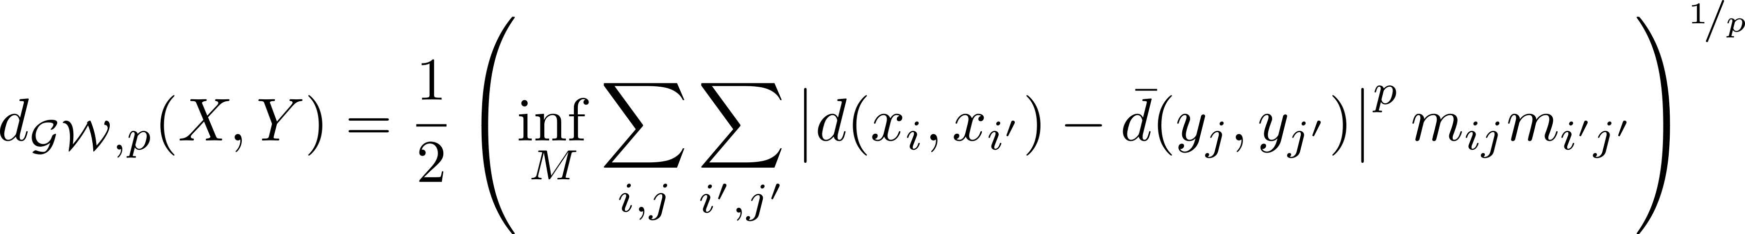




Gromov-Wasserstein distance
$$d$$
$$\overline{d}$$
$$X$$
$$Y$$
Notes:
Quadratic assignment problem
M means solving graph matching
Construction obvjously perm invariant, scale and size depends on d
We need a smulti-scaleness in d

Slide 55
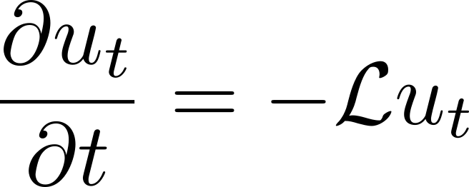
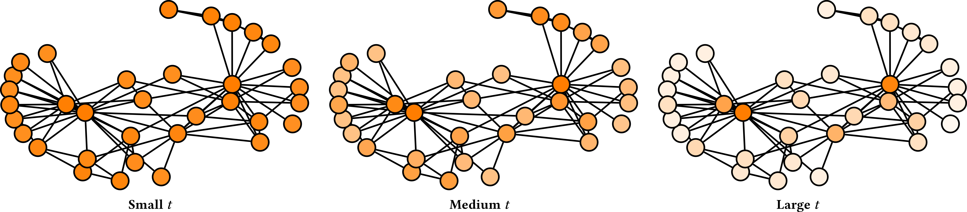
Heat diffusion has an explicit notion of scale

Slide 56
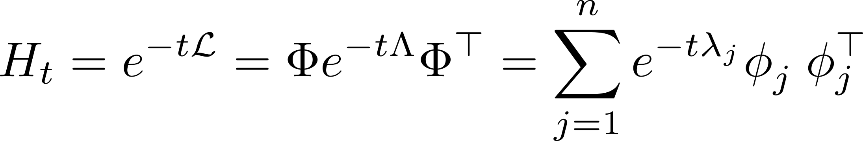
Heat kernel has an explicit notion of scale

Slide 57
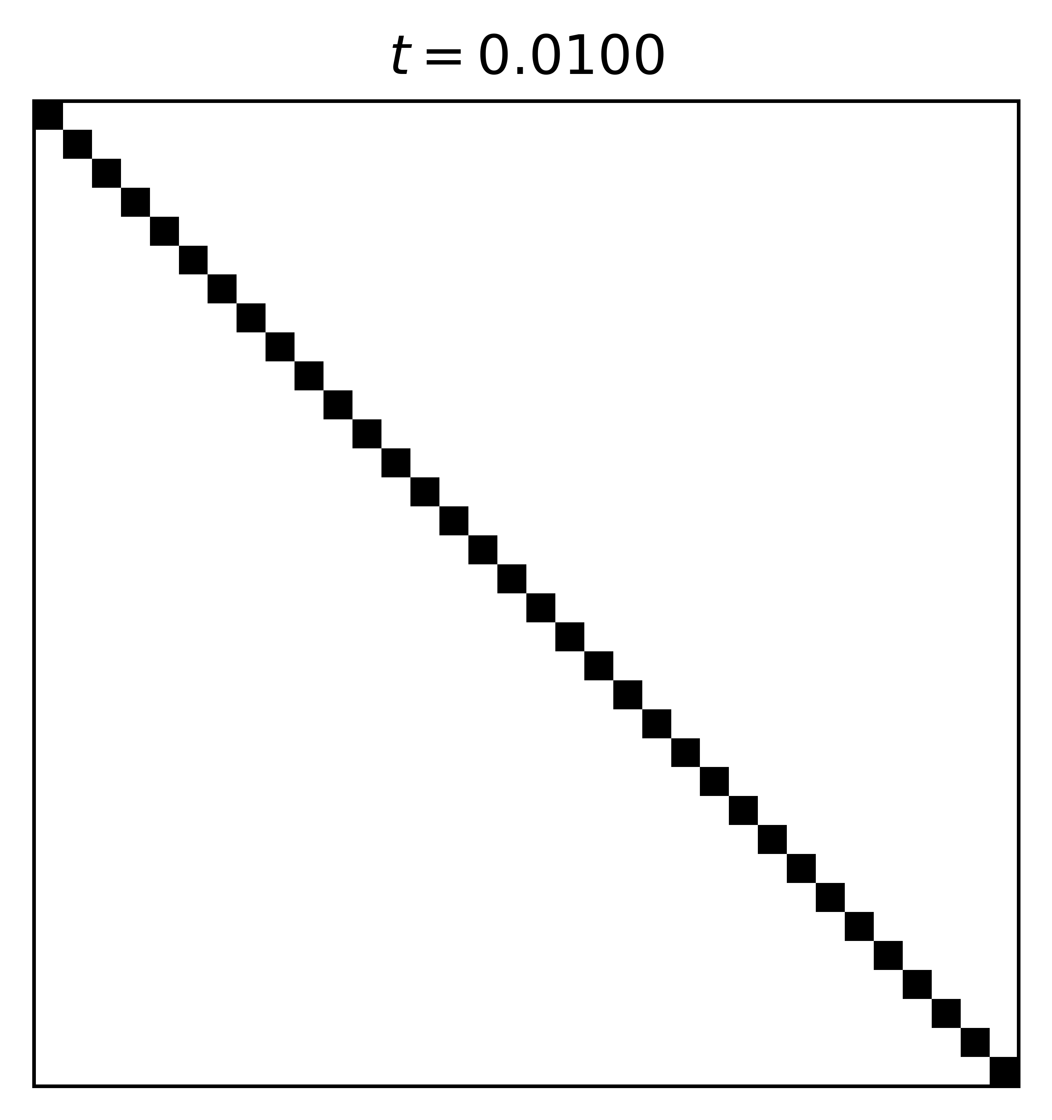
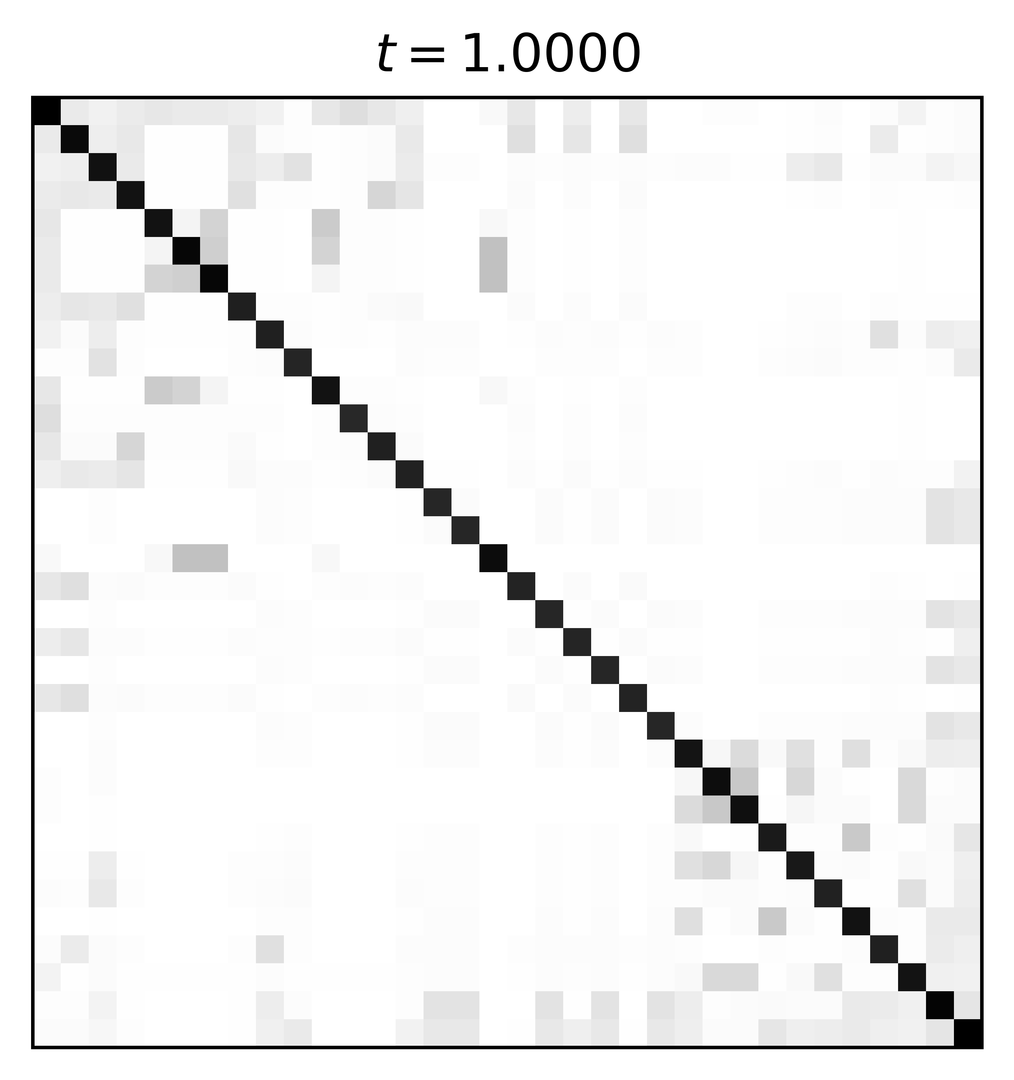
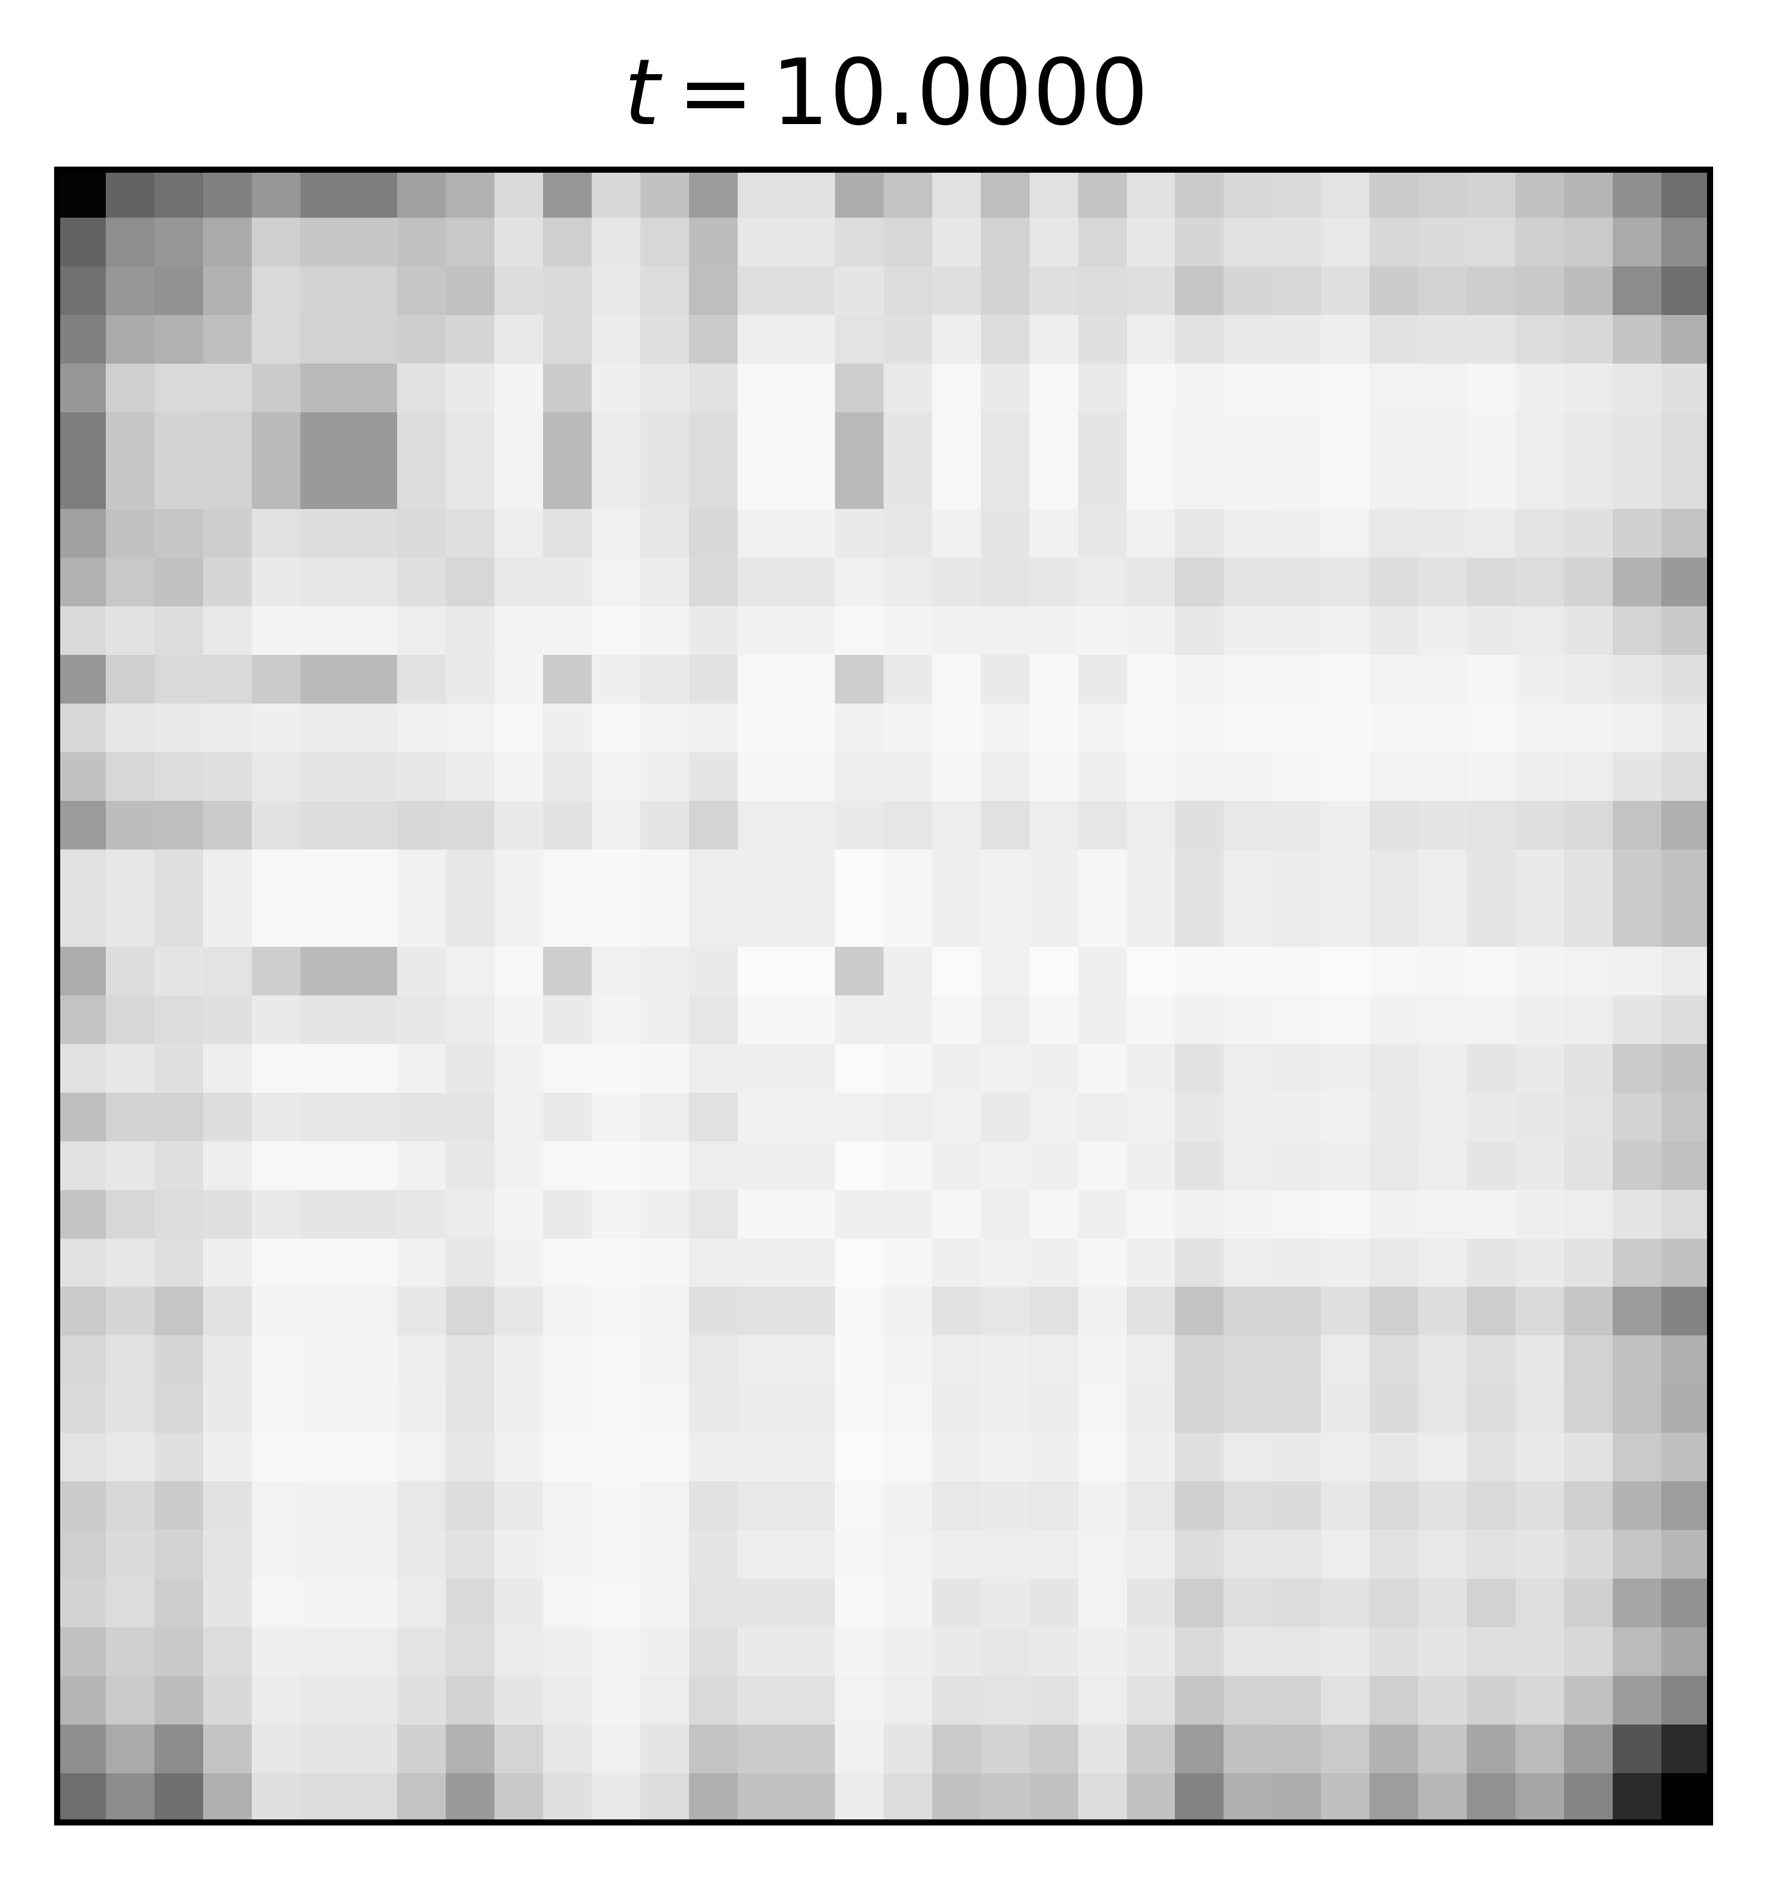
Scale corresponds to locality

Slide 58
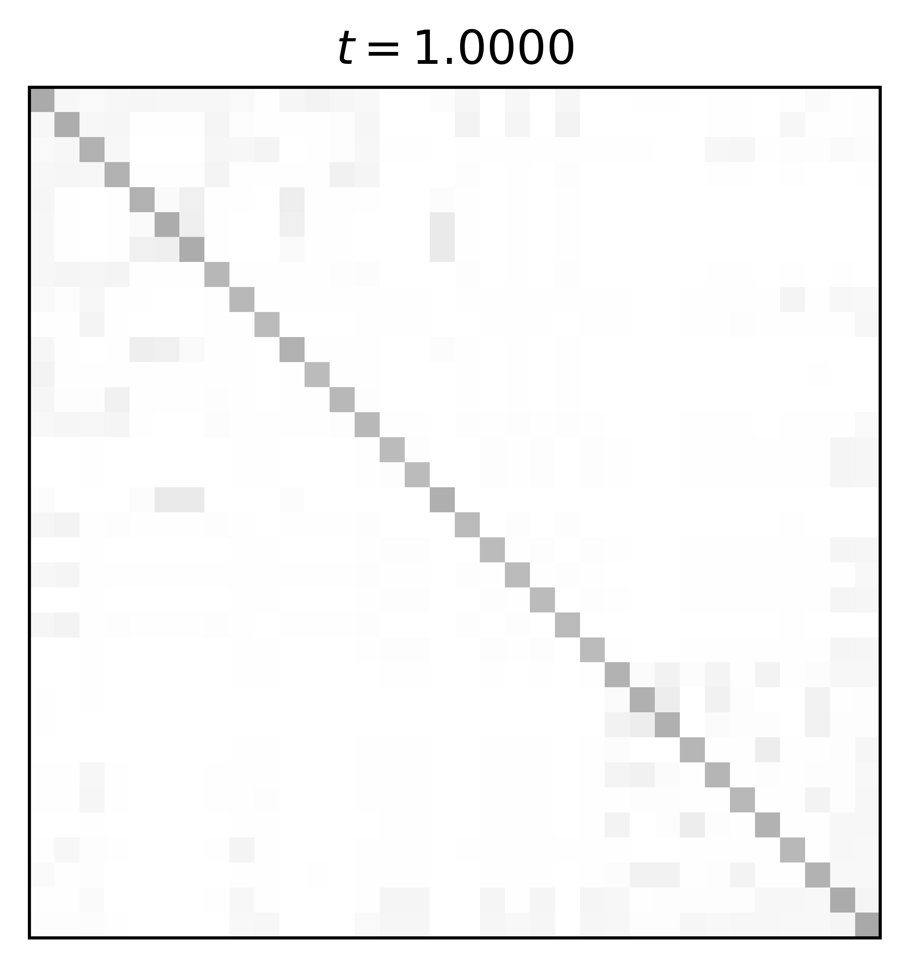

Scale corresponds to locality

Slide 59
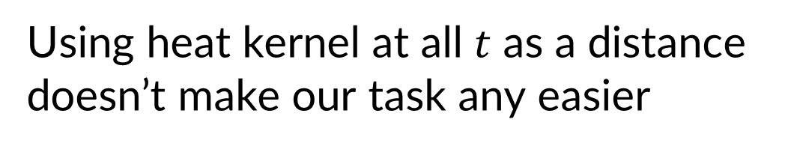
Spectral Gromov-Wasserstein =
Gromov-Wasserstein + heat kernel
Using heat kernel at all $t$ as a distance
doesn’t make our task any easier

Slide 60
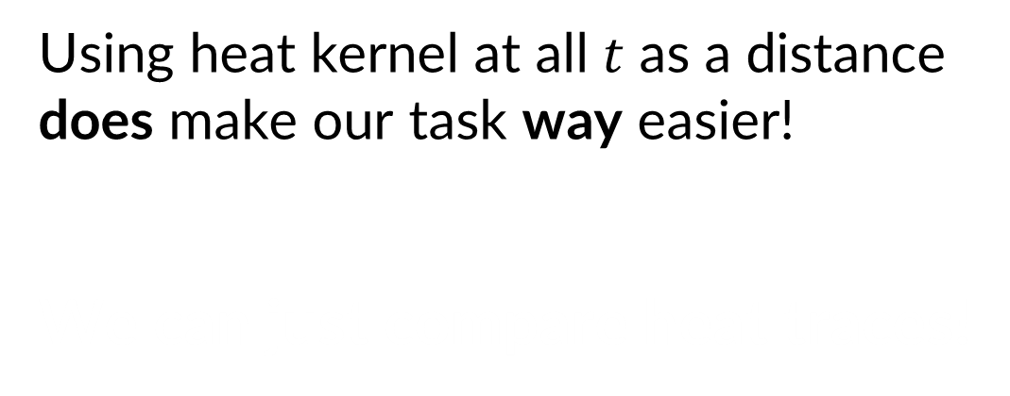
Spectral Gromov-Wasserstein has a useful lower bound!
Using heat kernel at all $t$ as a distance
does make our task way easier!
We can just compare heat traces!

Slide 61
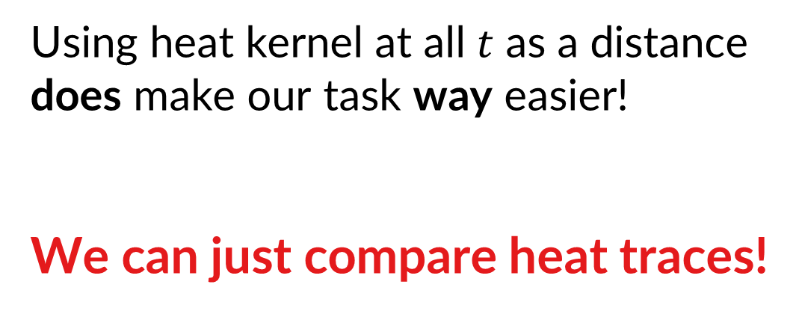
Spectral Gromov-Wasserstein has a useful lower bound!
Using heat kernel at all $t$ as a distance
does make our task way easier!
We can just compare heat traces!

Slide 62
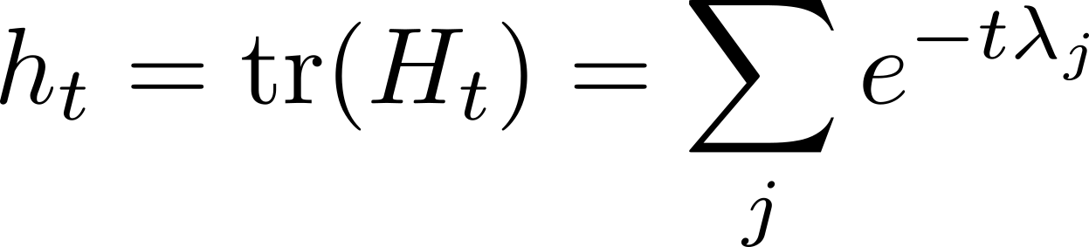

Network Laplacian Spectral Descriptors
We sample $t$ logarithmically, and compare $h_{t}$ with $L_{2}$ distance
However, $h_{t}$ is size-dependent!
Notes:
H_t as a filter
Wave kernel, learning

Slide 63

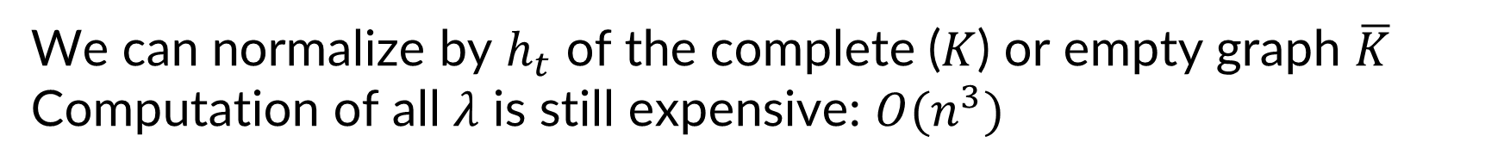
Size invariance $=$ normalization
We can normalize by $h_{t}$ of the complete ($K$) or empty graph $\overline{K}$
Computation of all $λ$ is still expensive: $O(n^{3})$

Slide 64
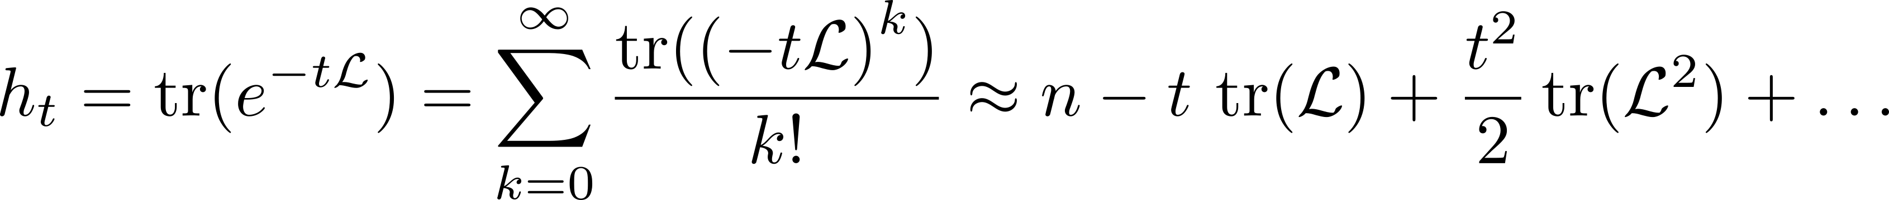
Scalability
We propose two options:
  Use local Taylor expansion:
    Second term is degree distribution; third is weighted triangle count
Notes:
Million-node graph in 15m

Slide 65
Scalability
We propose two options:
  Use local Taylor expansion:
    Second term is degree distribution; third is weighted triangle count
  Compute top + bottom eigenvalues, approximate the rest
    Linear extrapolation = explicit assumption on the manifold (Weyl’s law)
Notes:
Million-node graph in 15m

Slide 66
Scalability
We propose two options:
  Use local Taylor expansion:
    Second term is degree distribution; third is weighted triangle count
  Compute top + bottom eigenvalues, approximate the rest
    Linear extrapolation = explicit assumption on the manifold (Weyl’s law)
Other spectrum approximators can be even more efficient!
[Cohen-Steiner et al. | KDD 2018]
[Adams et al. | arXiv 1802.03451]
Notes:
Million-node graph in 15m

Slide 67
Experimental design
3 key properties:
  Permutation invariance
  Scale-adaptivity
  Size invariance

Slide 68
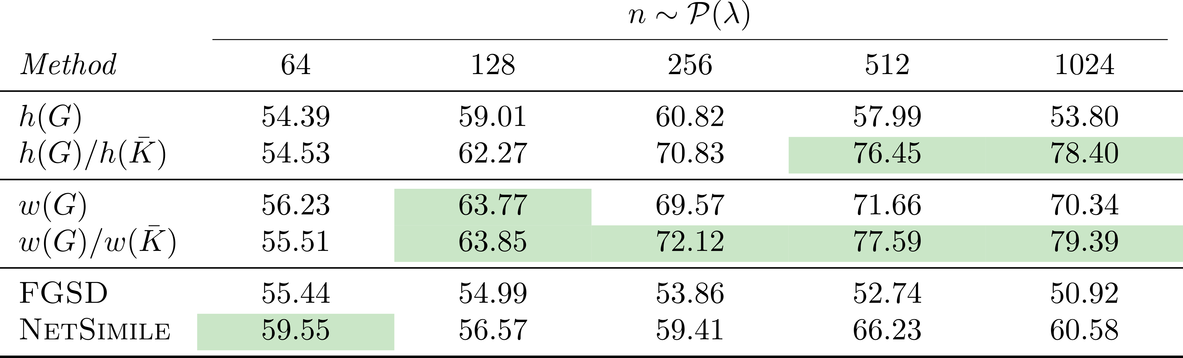
Detecting graphs with communities
3 key properties:
  Permutation invariance
  Scale-adaptivity
  Size invariance
NetLSD
NIPS’17
ASONAM’13
Accuracy of classification of SBM vs Erdős–Rényi graphs

Slide 69
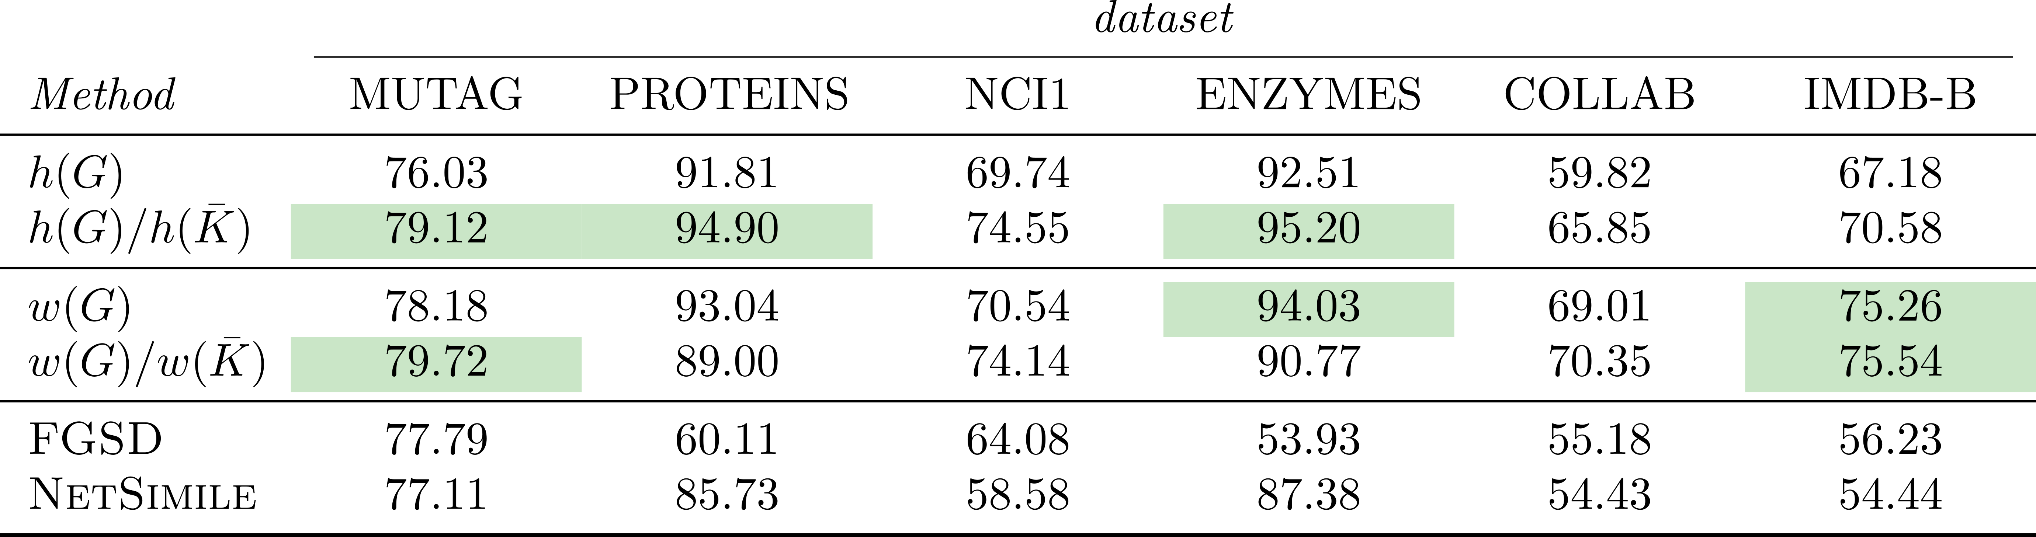
Detecting rewired graphs
3 key properties:
  Permutation invariance
  Scale-adaptivity
  Size invariance
NetLSD
NIPS’17
ASONAM’13
Accuracy of classification of real vs rewired graphs

Slide 70
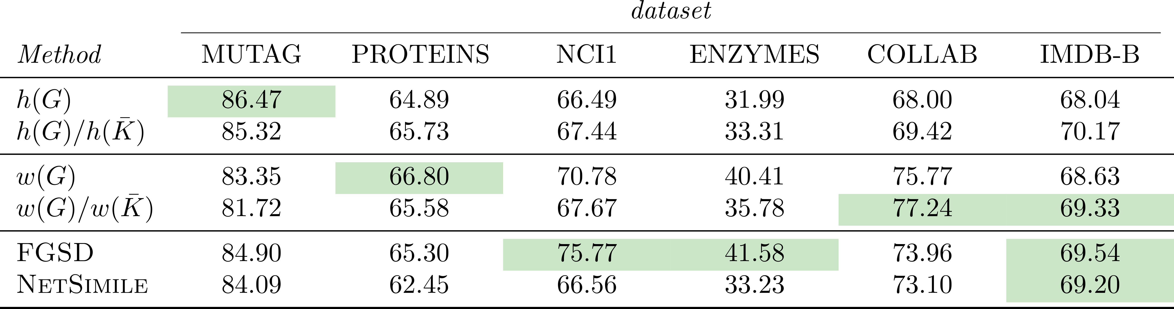
Classifying real graphs
3 key properties:
  Permutation invariance
  Scale-adaptivity
  Size invariance
NetLSD
NIPS’17
ASONAM’13
Accuracy of graph classification

Slide 71
Expressive graph comparison
3 key properties:
  Permutation invariance
  Scale-adaptivity
  Size invariance
+ Scalability
= NetLSD

Slide 72

Questions?
code + data github.com/xgfs
website tsitsul.in ← presentation will be there
write me anton@tsitsul.in

Slide 73
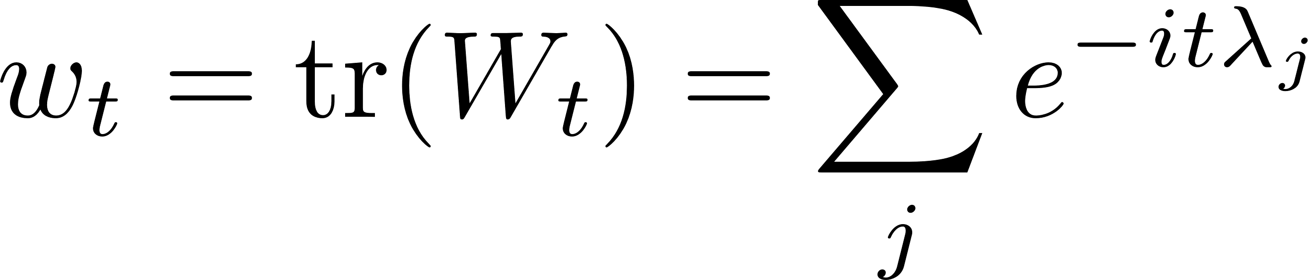
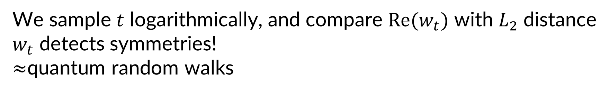
Network Laplacian Spectral Descriptors: wave kernel trace
We sample $t$ logarithmically, and compare $\text{Re}(w_{t})$ with $L_{2}$ distance
$w_{t}$ detects symmetries!
$≈$quantum random walks

Slide 74
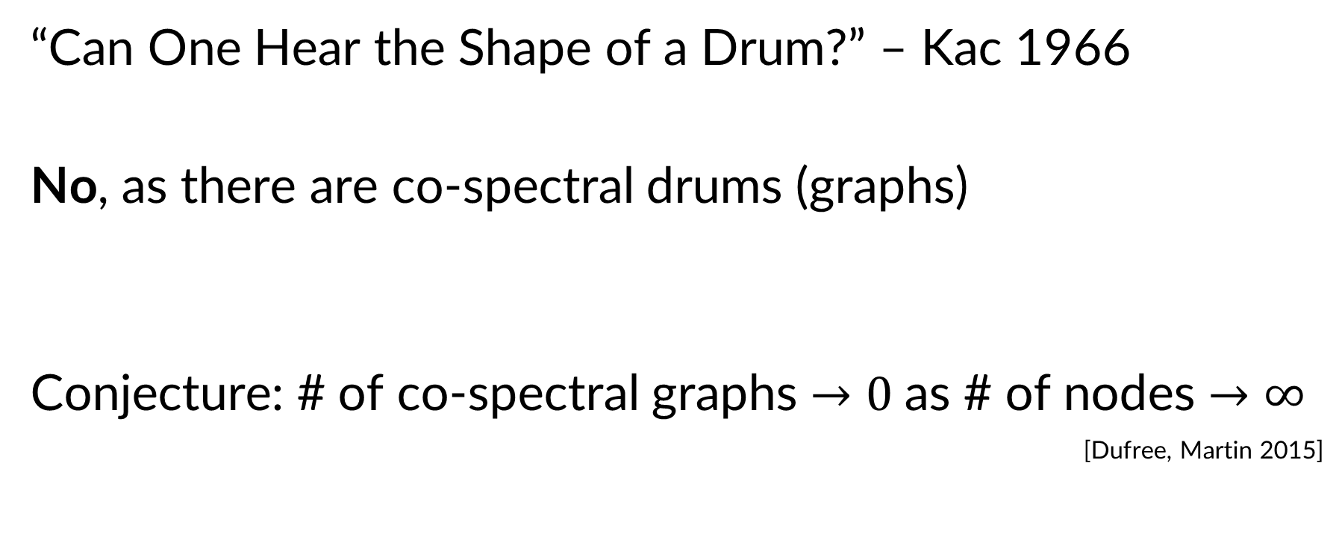
Hearing the Shape of a Graph
“Can One Hear the Shape of a Drum?” – Kac 1966
No, as there are co-spectral drums (graphs)
Conjecture: # of co-spectral graphs $→0$as # of nodes $→∞$
[Dufree, Martin 2015]

